Slide 1

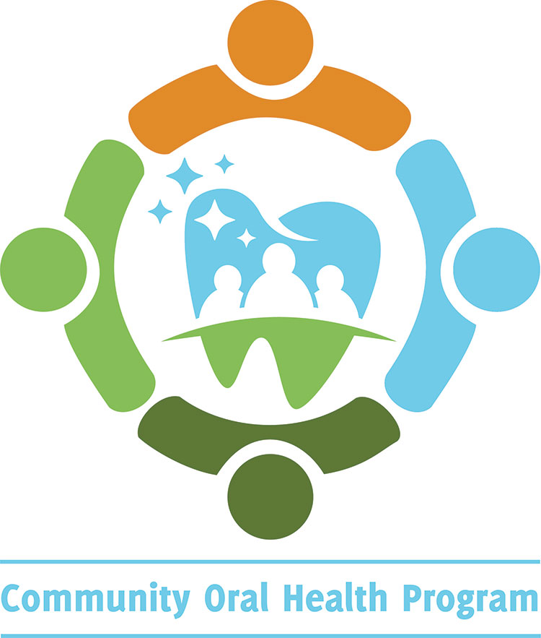
Perinatal Oral Health:
An Oral Health Guide To Support Expectant Parents
Contra Costa Health Services
Community Oral Health Program (COHP)
4/21
Notes:
Introduction:
Introduce yourself and the program
PowerPoint is available online: (cchealth.org/dental)
Ask audience if there are any questions before beginning. Consider writing suggestions or questions on paper/board for follow up.
Encourage audience to ask questions.
Note from the Contra Costa Community Oral Health Program: Please customize slides to adapt to your program.
**Target Audience: Parents

Slide 2
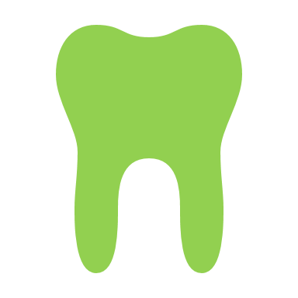



To Learn and Review:
Importance of oral health for expectant parents and baby
Identify habits that help keep a healthy mouth
Recognize common oral health conditions experienced during pregnancy
Review ways to care for a newborn’s mouth and the stages beyond
Notes:
To Learn and Review:
The importance of oral health for expectant parents and baby.
Identify habits which help keep a healthy mouth.
Recognize common oral health conditions during pregnancy and tips on how to help treat them.
And finally, ways to best care for a newborn or infants' mouth so they’re off to a healthy start!

Slide 3


Oral Health Matters For You And Baby!
Taking care of oral health
  Includes parts of the mouth like teeth, gums, tongue and the muscles that help us smile
  Having healthy teeth and gums help us to easily talk, eat and digest foods that fuel our body
  Modeling the importance of oral health early by practicing healthy habits can lead to more positive dental check ups for you and your family
Notes:
Oral Health Matters for You and Baby:
Oral health refers to the well being of the structures around both inside and outside your mouth. For example, it can include parts like your tongue, lips, teeth and muscles that help you smile.
Everyday we need our teeth and gums to do simple, but important things like talk, smile, chew and eat foods that help keep our body healthy.
It’s also very important for expectant mothers to pay attention early so they can get a head start on:
Being able to eat well and pass on those important nutrients to their baby
Making it easier to care for their own mouth as they start their pregnancy journey
Reducing cavity causing bacteria which can get passed on to their little ones
Finally, by learning and practicing good oral habits now, parents serve as positive role models for future successful family dental check ups! It is important to serve as a good role model for healthy habits and positive dental check ups.

Slide 4
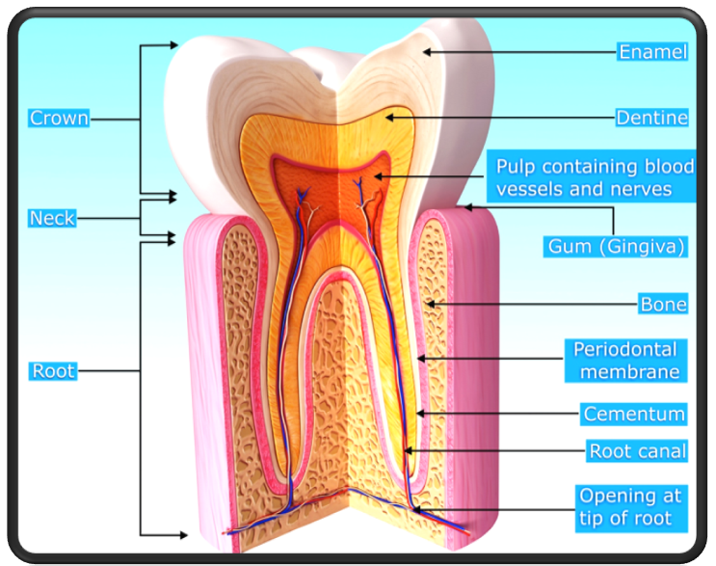
What Makes Up Healthy Teeth And Gums?
The Enamel, also known as the hardest substance in the body
The Dentin, transmits sensations
to the pulp
The Pulp, location of nerves and blood supply
Gums/Gingiva, pink tissue that helps support and protect teeth and bone
Notes:
What Makes Up Healthy Teeth And Gums?
In order to understand how to keep our mouth healthy, let’s first look at what normal or healthy teeth look like.
If we were to slice a tooth, this is what you would see:
The first or outer layer is called the Enamel.
It is a hard, protective covering and in fact, it is the hardest substance in our body!
The next layer which is a bit softer and more yellowish is called the Dentin.
Is it made up of channels that pass along sensations like pressure, hot or cold onto the next layer called the pulp.
The pulp is where the nerves and blood supply are.
It is also important to point out the gums or gingiva, which is the pink tissue that surrounds and supports bone and teeth.
Healthy and stable teeth and gums allows us to comfortably do the things we talked about before.

Slide 5
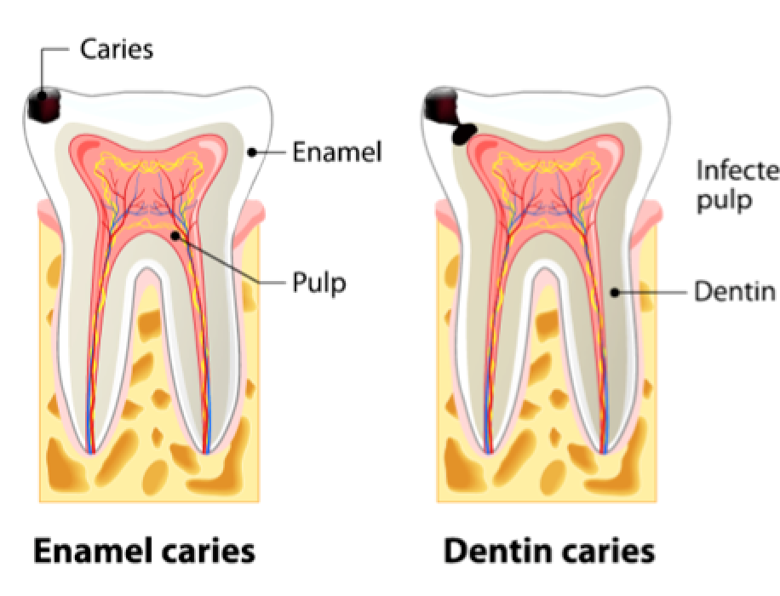
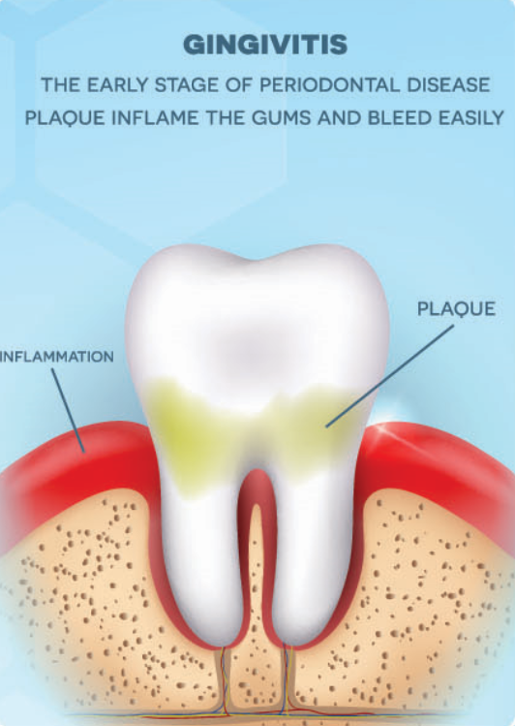
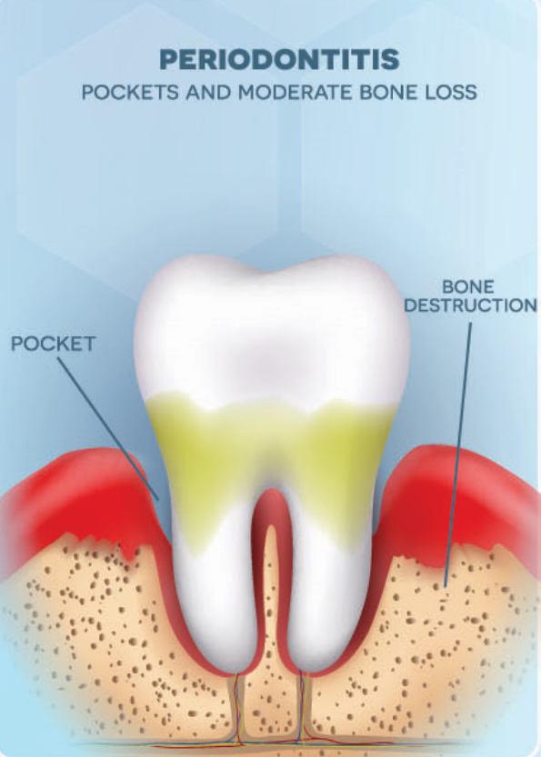
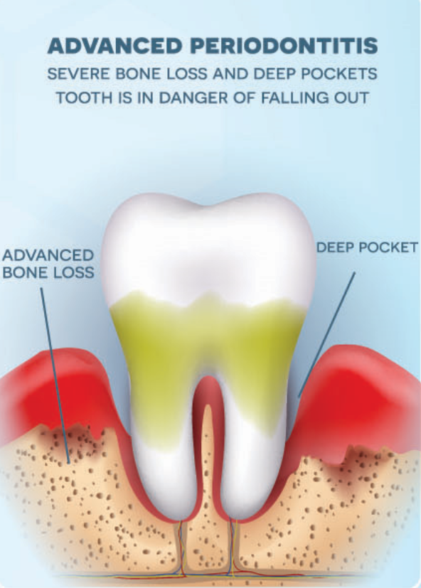
Common Dental Problems
Caries = Tooth decay aka cavities
Gingivitis =
Inflamed gums
Periodontal Disease =
Bone loss around the teeth
Notes:
Common Dental Problems:
When teeth and gums are diseased, there are a few terms used to describe these problems:
You may have heard words like dental caries, tooth decay or cavities which all refer to same process. Cavities form when the enamel or hard, outer layer of the tooth breaks down and creates a hole or cavity in the tooth. We’ll go over that in more detail on the next slide.
Another term, you may have heard is gingivitis or gum disease. It starts when plaque and leftover food builds up on teeth and does not get properly cleaned away.
Plaque is a soft, sticky film full of bacteria that forms on your teeth everyday. If it’s not removed by brushing and flossing, it can cause red, swollen and puffy gums.
Over time, if the plaque is not removed it can also harden into something called tartar or calculus. This can continue to cause irritated, bleeding gums which can eventually trigger an inflammation process that leads to the destruction of bone surrounding the tooth. That means over time, without proper care, teeth can get wiggly and may eventually fall out.
References:
American Dental Association: Mouth Healthy. (n.d. a). Decay. Retrieved from https://www.mouthhealthy.org/en/az-topics/d/decay#:~:text=Tooth%20decay%20is%20the%20destruction,acids%20that%20attack%20tooth%20enamel.
American Dental Association: Mouth Healthy. (n.d. b). Gum disease. Retrieved from https://www.mouthhealthy.org/en/az-topics/g/gum-disease

Slide 6





Bacteria
Sugary Food & Drinks
Acid Attack
The Decay Process
Notes:
The Decay Process:
So how does the strongest substance in the body, enamel get destroyed?
Well, it all begins with:
Bacteria that can be found in the mouth, plus a diet full of processed, sugary foods or drinks can lead to an acid attack.
The bacteria feeds on these sugars leaving an acidic environment in our mouth.

Slide 7
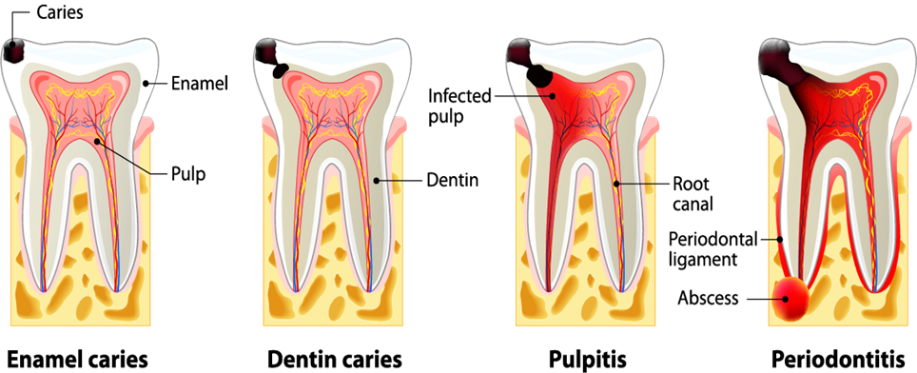
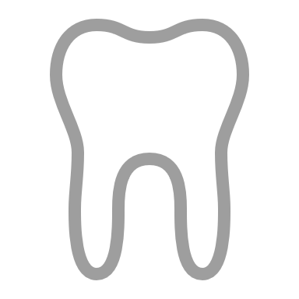

Decay Process Continued
Acid Attack
Teeth
Cavity or Decay
Time
Notes:
The Decay Process Continued:
It is these repeated acid attacks over time that make holes or cavities.
Remember, try to avoid sugary and sticky foods like candy or crackers that can get stuck in the grooves of teeth.
How often or the number of times you snack with foods rich in carbohydrates/sugars can also make teeth vulnerable to acid attacks. After consulting your doctor, consider including snack choices rich in protein or fiber like cheese, apples, etc.
Luckily, our body does have natural protective factors like salvia or spit that help neutralize these acid attacks and protect us from getting cavities. Outside factors like fluoride sometimes found in tap water, can also help repair or re-mineralize any “soft spots” where the tooth is getting weaker.
By understanding how cavities happen, hopefully you feel empowered to make decisions that can help maintain a healthy mouth!
Let’s take a closer look with pictures, how the decay process happens in the next slide.

Slide 8
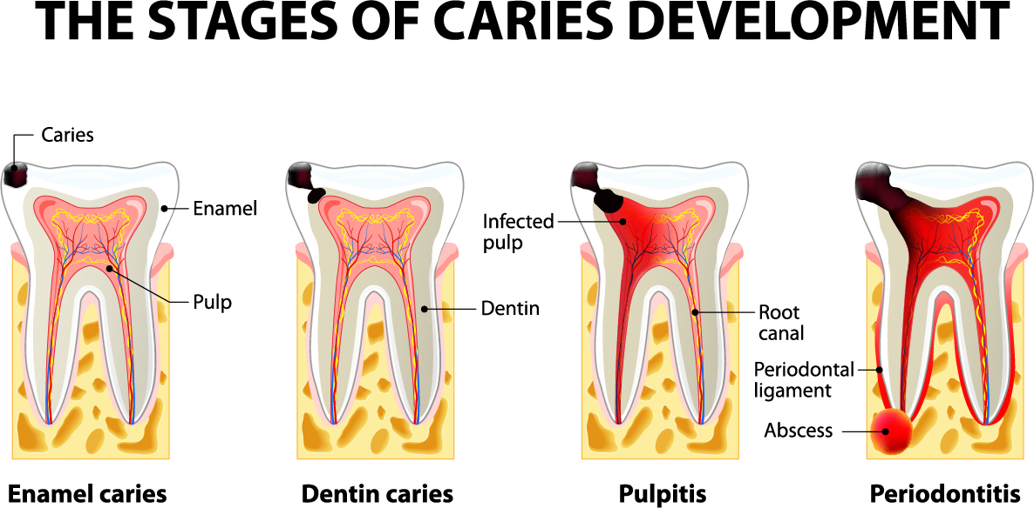
Stages of Tooth Decay
Notes:
Stages of Tooth Decay:
Key Message: Do not wait until something begins to hurt! Early visits to the dentist can help identify problems before they become an issue.
Here’s a diagram that explains how overtime, untreated cavities can get bigger:
When food particles and plaque, which is that soft, sticky film we mentioned before, is not cleaned away, it can eventually breakdown teeth and effect the surrounding bone.
By brushing two times a day and flossing nightly, we can remove the plaque on a regular basis.
The first picture shows the early stages of decay when the cavity is just on the outer layer of the tooth. Remember, a cavity can also form in between teeth and dental x rays can help detect it.
Sometimes, this early caries or soft spot can get re-mineralized or repaired by using fluoride treatments. It is important though to monitor any of these areas and follow up with regular dental check ups to make sure a cavity is not getting bigger.
If it does get deeper into the second layer of the tooth, dentin, then an oral healthcare professional may treat it by removing or cleaning out the cavity and placing a filling.
However, if there was no follow up or treatment, then over time the bacteria in the cavity can get in the pulp. This can lead to pain, swelling and/or an infection called an abscess. Depending on how severe the infection is, it may need urgent medical care.
Waiting until the decay goes to the pulp can mean more invasive or costly dental treatment options like a root canal or extraction (removal of the tooth).

Slide 9

Protective Factors
Remember, tooth decay can be prevented
Saliva
Oral Hygiene
Diet
Fluoride
Dental Sealants
Notes:
Protective Factors:
Fortunately, by taking some consistent, simple steps everyday, we can help reduce both our and our loved one's risk from experiencing cavities.
Tooth decay can be preventable!
Here are some protective factors that can help:
Saliva or spit that is already in our mouth, can help to buffer or neutralize acid attacks that lead to cavities. Salvia also has other protective elements that help make teeth stronger. If you experience dry mouth as a result of medications, chewing Xylitol gum can help to stimulate spit.
Oral hygiene: This refers to the practice of keeping teeth, gums and your mouth clean and healthy. Brushing and flossing can help improve your oral hygiene.
Diet: Choosing foods that are not processed or have lesser amounts of sugar can improve your oral and overall health.
Fluoride: Is a naturally occurring mineral that can be found in soil, plants and foods such as spinach and potatoes. Fluoride helps to strengthen and protect teeth from cavities. This has been proven with decades of studies by credible organizations like the Centers for Disease Control and Prevention (CDC).
Fluoride can also be added to drinking water, toothpaste and mouthwashes.
Use a fluoridated toothpaste and for maximum benefit, after brushing do not rinse your mouth out with water. Instead, spit out excess toothpaste and allow the remaining toothpaste to help strengthen your teeth.
Choose tap water for drinking and cooking.
For more details about your local water supply, log onto to your water company’s website to review their annual quality report. If babies are in a non-fluoridated water or well water drinking community or are at a high risk for decay, the pediatrician or pediatric dentist may recommend supplementing with drops.
For more detailed information or specific questions, remember to always consult with your healthcare provider team.
Sealants: This is a coating or covering that is applied on the grooves of the back teeth.
We’ll go over this in more detail later. Remember, we don’t have to experience cavities- a few simple steps can reduce our risk.
References:
American Dental Association [ADA]. (2018). Practical guide series: Fluoridation facts. Retrieved from https://www.ada.org/en/public-programs/advocating-for-the-public/fluoride-and-fluoridation/fluoridation-facts
Centers for Disease Control and Prevention [CDC]. (1999). Ten great public health achievements– United States 1900-1999. Retrieved from https://www.cdc.gov/mmwr/preview/mmwrhtml/00056796.htm#:~:text=%20Ten%20Great%20Public%20Health%20Achievements%20--%20United,use%20as%20a%20health%20hazard%20%20More%20

Slide 10
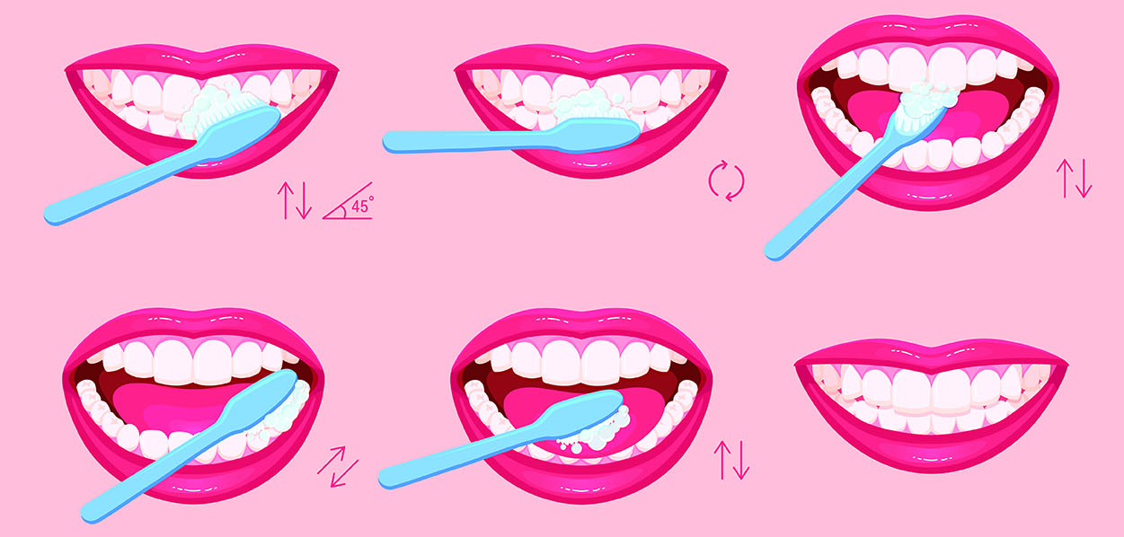
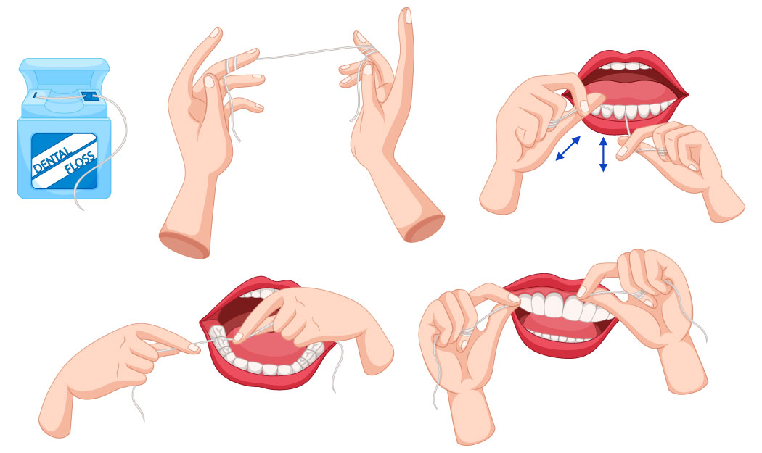
Tips and Techniques
Brushing
Brush at least 2x times a day
Focus on small circular strokes using a soft bristled brush
Try other options such as electric toothbrushes
Flossing
Floss at least 1x per day
Flossing helps remove plaque and keep gums from bleeding, being swollen or irritated
Start today and continue daily
Notes:
Tips and Techniques:
Now let’s talk more in detail about some action steps you can take to make a difference on your oral health.
Start off with simply:
Brushing 2 times a day with a soft bristled toothbrush.
Using a manual toothbrush, focus on creating small circular strokes on all teeth surfaces and gently around your gumline.
If using an electric toothbrush, hold it in place and allow it to do the work vibrating on the teeth and gums.
Floss everyday
Flossing gets your mouth even cleaner by removing the plaque in between teeth.
Doing it daily can help reduce problems with puffy, irritated, bleeding gums or gingivitis.
Start today and keep it up! If it helps, bring floss or floss picks into the shower and complete while conditioning hair or get creative with other ways to remember daily brushing and flossing!

Slide 11
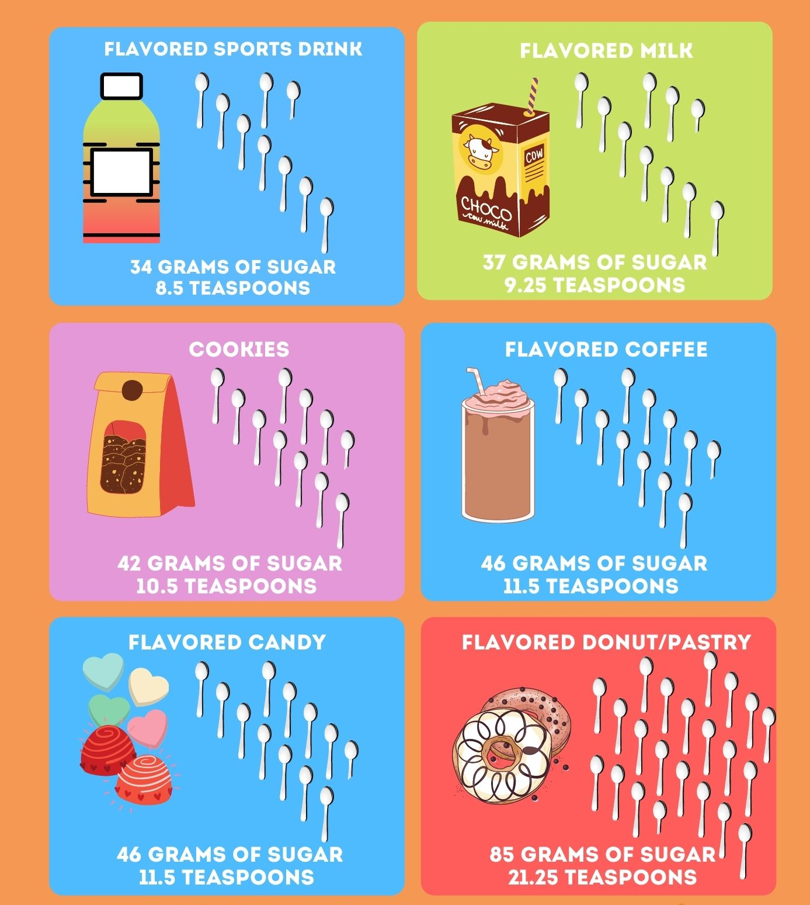
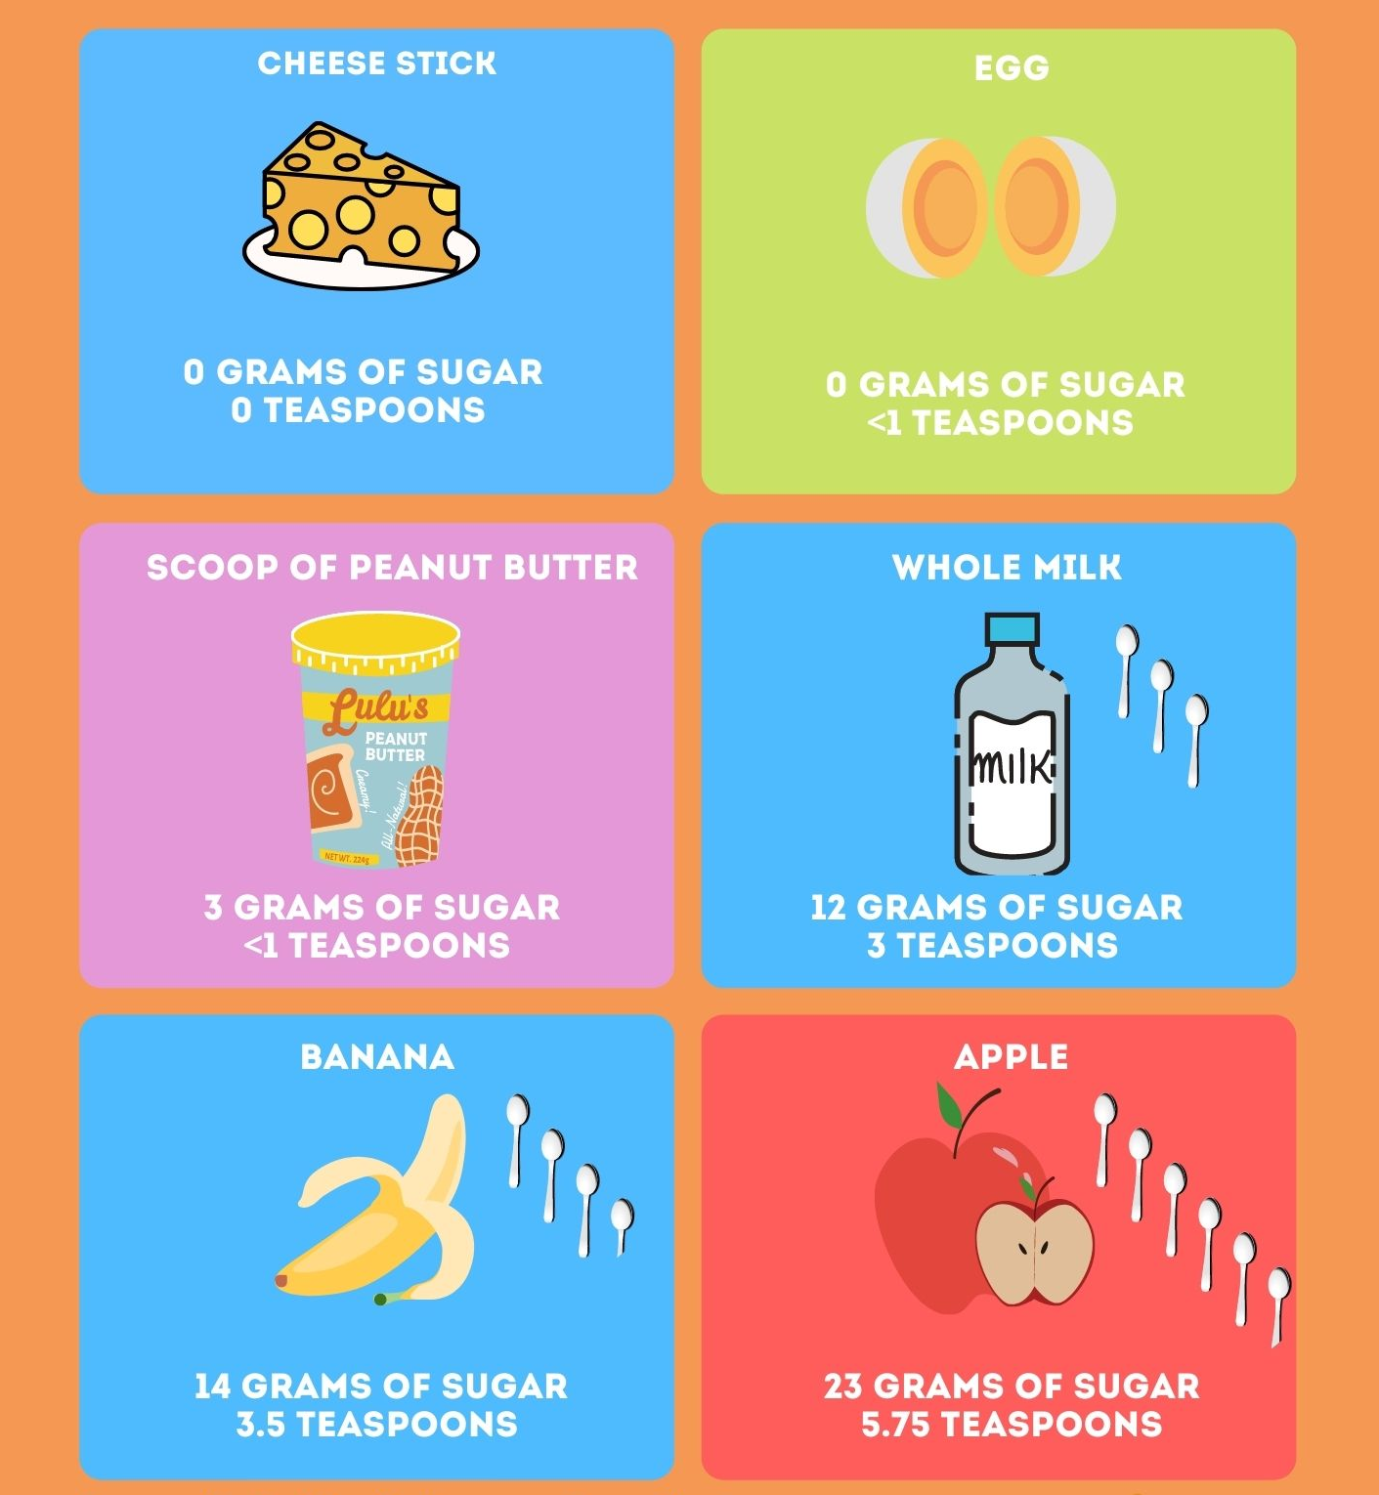
What We Eat Affects our Teeth
Notes:
What We Eat Affects Our Teeth:
Here we have some common snacks, treats, and drinks along the amount of sugar in each serving.
When reading the nutrition label, sugars are measured in grams.
4 grams of sugar = 1 teaspoon.
Next time, you reach for a treat, read the label, serving size and the number of grams to see how many teaspoons of sugar you are actually taking in.
You may be surprised! On the left, are just some samples of what you may find.
On the right are samples of snacks you may decide to reach for instead. Check out the number of teaspoons of sugar here.
Eating healthy foods are important in general, but even more so during pregnancy. Mothers are now eating for two and help provide critical nutrients to their growing child. Babies' teeth begin to develop between the third and sixth months of pregnancy.
Remember to always consult with your doctor about your specific needs and discuss how best to get teeth friendly nutrients like vitamins A, C, and D, protein, calcium and phosphorous as part of your diet.
Pregnancy can affect the way mother’s take in food:
For example, some can experience nausea and have difficulty keeping foods down.
Others may have the urge to snack constantly. While it’s normal to have an increase in appetite, remember frequent snacking can be an invitation to tooth decay.
So just keep in mind when you snack, choose foods that provide more nutrients such as raw fruits and vegetables.
Although the one serving of the apple here has 5.75 teaspoons of sugar, it also contains fiber, natural sugars and texture that prevent it from sticking to teeth and causing decay like other refined sugar choices do.
Get creative with your options and pair foods like hummus & veggies, or fruits with yogurt, cottage cheese or peanut butter.
References
Delta Dental of Michigan, Ohio, and Indiana. (2016). Rethink your drink, choose water! Okemos, MI: Delta Dental Foundation. 7. Retrieved from www.deltadentalmi.com/MediaLibraries/Global/documents/6255-Rethink-Your-Drink-Brochure.Pdf

Slide 12
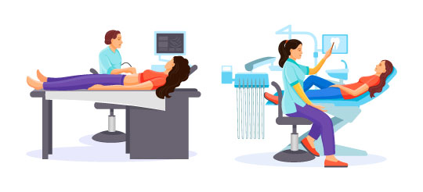
Dental Visits
Routine and preventive dental visits during pregnancy are recommended and safe
Let your provider know you’re expecting
At an exam visit, a lead apron with a neck collar that covers the chest and belly will be used
Postpone elective or non-essential treatments like teeth whitening
2nd trimester is ideal to get work done due to comfort in the dental chair position and reduce chances of premature labor
Notes:
Dental Visits:
Routine and preventive visits are recommended and safe during pregnancy. American College of Obstetricians and Gynecologists (ACOG) recommend to get a “dental check up early in pregnancy”. This can help detect any dental issues so they can be addressed early on.
Let your dental provider know you’re expecting, any new medications you are taking or any special advice from your physician.
In general, before taking dental x-rays, a lead apron with a neck collar that covers the chest and belly is used to reduce any exposure.
Your dental provider may recommend postponing elective procedures like teeth whitening and scheduling more appointments for cleaning especially during the 2nd and early 3rd trimester. If you need an emergency procedure, work with your dentist on the best plan for the health of you and your baby.
Reference
American College of Obstetricians and Gynecologists [ACOG]. (2017). Oral health care during pregnancy and through the lifespan. Retrieved from https://www.acog.org/clinical/clinical-guidance/committee-opinion/articles/2013/08/oral-health-care-during-pregnancy-and-through-the-lifespan
American Dental Association: Mouth healthy. (n.d.). Pregnant? 9 questions you may have about your dental health. Retrieved from https://www.mouthhealthy.org/en/pregnancy

Slide 13

Tips and Tricks
Take it slow and figure out what works best for you!
Bring a pillow to help keep you and baby comfortable during your visit
Bring headphones and your favorite music
Keep legs uncrossed while sitting in a dental chair
Notes:
Tips and Tricks:
Check in with the office to see if you can:
Bring a pillow to help keep comfortable when you lay in the dental chair
Bring headphones and your favorite music to help you relax
Keep legs uncrossed while sitting in dental chair
Remember, take it slow, discuss things over with your dental professional and figure out what works for you.
References:
American Dental Association: Mouth healthy. (n.d.). Pregnant? 9 questions you may have about your dental health. Retrieved from https://www.mouthhealthy.org/en/pregnancy

Slide 14
Common Concerns During Pregnancy
Coping With Morning Sickness, Pregnancy Gum Growths, Nausea or Vomiting
Morning sickness or frequent vomiting
Acid from vomiting breaks
down the enamel of our teeth
For sensitive gag reflex leading to nausea or vomiting
Use a toothbrush
with a smaller head
Do not brush right
after instead rinse
1 cup of water to
teaspoon of baking soda
Then brush 30 minutes after
Explore alternative
tasting toothpaste
Try brushing at different
times of the day
Notes:
Coping With Morning Sickness, Nausea, or Vomiting
Issues besides tooth decay and gum disease can affect expectant mothers.
Let’s look at some common ones, such as morning sickness or frequent vomiting
Some women experience this early or throughout their pregnancy. Similar to the acid attack we learned about with eating sugary foods, an acidic environment in the mouth from vomiting can also lead to the breakdown of enamel.
That is why it’s recommended to not brush right after vomiting, but instead to rinse.
You can rinse with 1 cup of water to 1 teaspoon of baking soda or plain water if easier.
Then brush gently 30 minutes later.
During this time, you may have a sensitive gag reflex or find that the brushing can trigger you to want to throw up.
Try a couple of these tricks that might help:
Use a toothbrush with a smaller head, change the flavor of toothpaste to something more mild, try brushing at different times of day when you may fee less nauseous.
Reference:
American Dental Association: Mouth Health. (n.d.). Pregnant? 9 questions you may have about your dental health. Relieved from https://www.mouthhealthy.org/en/pregnancy

Slide 15
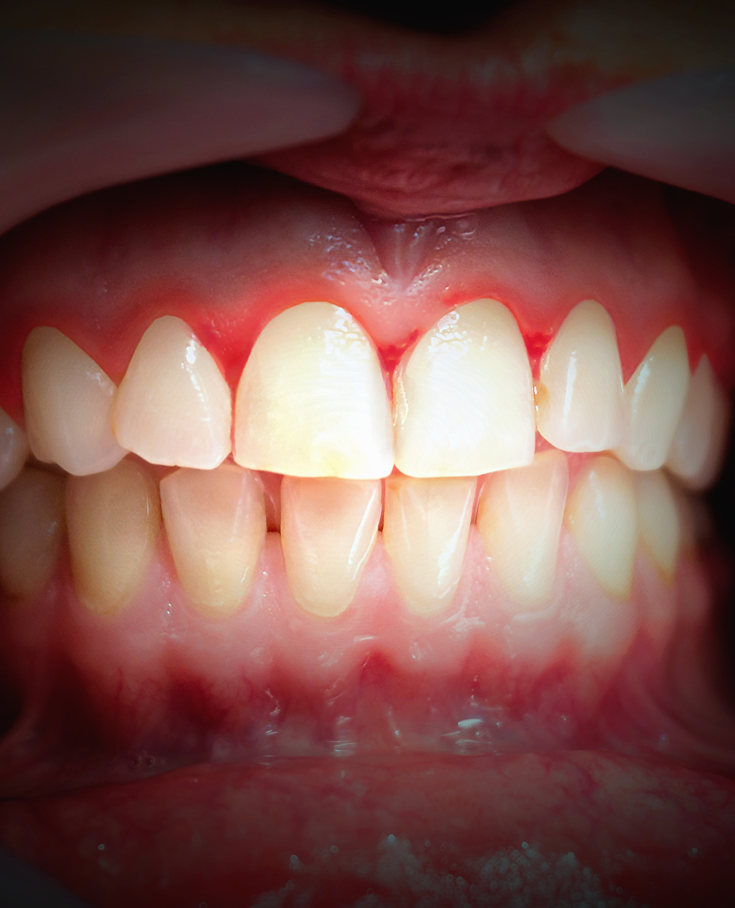
Why Are My Gums Bleeding?
Pregnancy Gingivitis is a mild form of gum disease that can occur when hormonal changes make your gums sensitive to bacteria in the gum tissue
Common between 2nd to 8th months of pregnancy
Prevention is key with daily brushing and flossing
Notes:
Why Are My Gums Bleeding?
Earlier in the presentation we spoke about what healthy gums look like. Remember gingivitis or inflamed, puffy, bleeding gums can happen when plaque and food pieces are not removed everyday.
During pregnancy, Gingivitis can happen from hormonal changes which can exaggerate the response to bacteria in the gum tissue.
As many as half of all women develop pregnancy gingivitis, which is a mild form of gum disease that is most common between the 2nd- 8th months of pregnancy. It usually goes away after childbirth.
Removing plaque daily by brushing and flossing can help, as well as visiting the dental office to determine how often you need to come in for a professional cleaning.

Slide 16
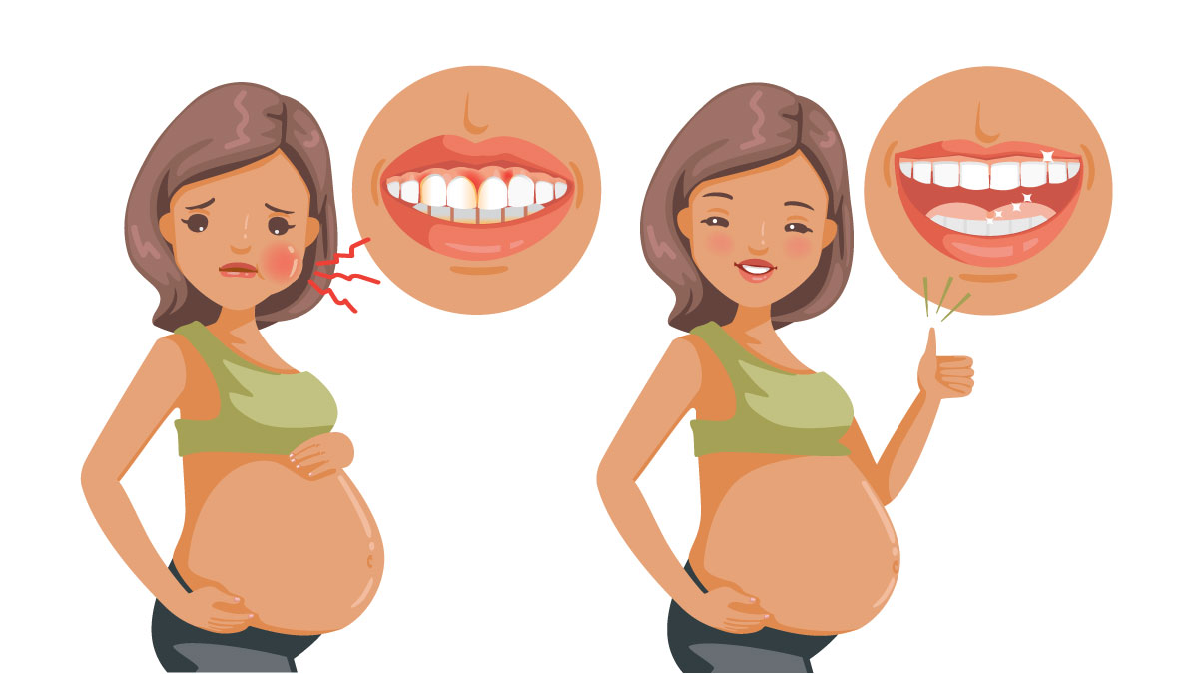
What Else Can Happen to
My Mouth During Pregnancy?
Pregnancy Gum Growth
Changes in hormones in the body
May develop benign growth (non-cancerous)
Notes:
What Else Can Happen to My Mouth During Pregnancy?
Pregnancy Gum Growths
Might find pink lump of gum tissue that is referred to as a gum or pregnancy tumor in the mouth.
Don’t worry, these growths are not cancerous or don’t spread to others.
They can happen because of the change in hormones in your body.
Usually, they can be found if the upper gum line and can be further irritated by plaque.
If it causes discomfort while talking or eating a dentist or specialist may be able to remove it
They can occur in the 2nd trimester and disappear on their own after childbirth.
References:
American Dental Association: Mouth Health. (n.d.). Pregnant? 9 questions you may have about your dental health. Relieved from https://www.mouthhealthy.org/en/pregnancy

Slide 17


Caring For Your Baby’s Oral Health Through the Years
Newborn: Nutrition and feeding
Toddler: Reducing bacteria transfer
Childhood: Adolescence and cavity prevention
Notes:
Now let’s transition to the final portion of the presentation- Caring for your baby’s oral health through the years!
The good oral hygiene habits you picked up during pregnancy will continue to have a positive affect on your overall health as well as your baby’s.
In the next slides we talk about a few important topics you may experience through the various stages of your child’s development.
These topics include
Feeding and Nutrition
Bacteria Transfer
Caries Prevention

Slide 18

Feeding, Nutrition and Oral Care
Breastfeeding
Breastfeed up to a child’s first year
Baby may have trouble sticking out tongue for a proper feed
Consider a consultation if baby has trouble latching
After feeding and before bed
Wipe gums down with wet wash cloth
Around 5-6 months:
  Expect baby to start teething, lower two front teeth will break through gums
Notes:
Feeding, Nutrition and Oral Care:
Breastfeeding is one of the first and most personal decisions a mother makes for her baby. It can help provide baby with nutrients and fight infections. The American Academy of Pediatrics focuses on breastfeeding strictly for the first 6 months of life to one full year.
Sometimes, breastfeeding is not possible or there are challenges. We encourage you to reach out to your medical providers and/or lactation consultants to discuss and evaluate your best options.
At times, babies may have difficulty latching because they are not able to stick their tongue all the way out, allowing them to get a proper latch. A referral to an oral health care professional may be considered.
Dental cavities can also develop on infants’ teeth since breast milk and formula contain sugars.
So, remember after every feeding and before going to bed at night, wipe your baby’s gums down with a wet washcloth.
Wrap the wet washcloth around your finger, gently rub your baby’s gums using a circular motion. Continue this until you have rubbed all of the gums and wipe down the insides of the cheek and tongue.
This routine will get your child used to you cleaning their mouth as they get older.
Around 6 months of age, expect your baby’s lower front teeth to make its way through the gums.
References
Smiles for Life (n.d.) Oral health and the pregnant patient: The maternal child linkage. Retrieved from https://www.smilesforlifeoralhealth.org/buildcontent.aspx?pagekey=63698&lastpagekey=66064&userkey=15435532&sessionkey=5658748&tut=560&customerkey=84&custsitegroupkey=0&btn=back

Slide 19


Bacteria Transfer
Bacteria in our mouth can be passed from parent/caregiver to child
Helpful reminders
Avoid cleaning pacifier with mouth and then giving it to baby
Taste test the temperature of foods with a separate spoon, avoid sharing
Have each family member use and own their own toothbrush
Avoid sharing spoons, cups and straws with your child
Notes:
Bacteria Transfer:
Germ/Bacteria Transfer also known as vertical transmission happens.
Here, cavity causing bacteria in the mouth can be passed from parent/caregiver to baby.
To prevent this from happening:
Avoid “cleaning” the pacifier with your own mouth and then giving it to baby.
Avoid sharing utensils with children.
Instead, you can taste test the temperature of their foods using a separate spoon.
Make sure that every family member has and uses their own toothbrush.
References
Smiles for Life (n.d.) Oral health and the pregnant patient: The maternal child linkage. Retrieved from https://www.smilesforlifeoralhealth.org/buildcontent.aspx?pagekey=63657&lastpagekey=66065&userkey=15435532&sessionkey=5658748&tut=560&customerkey=84&custsitegroupkey=0

Slide 20
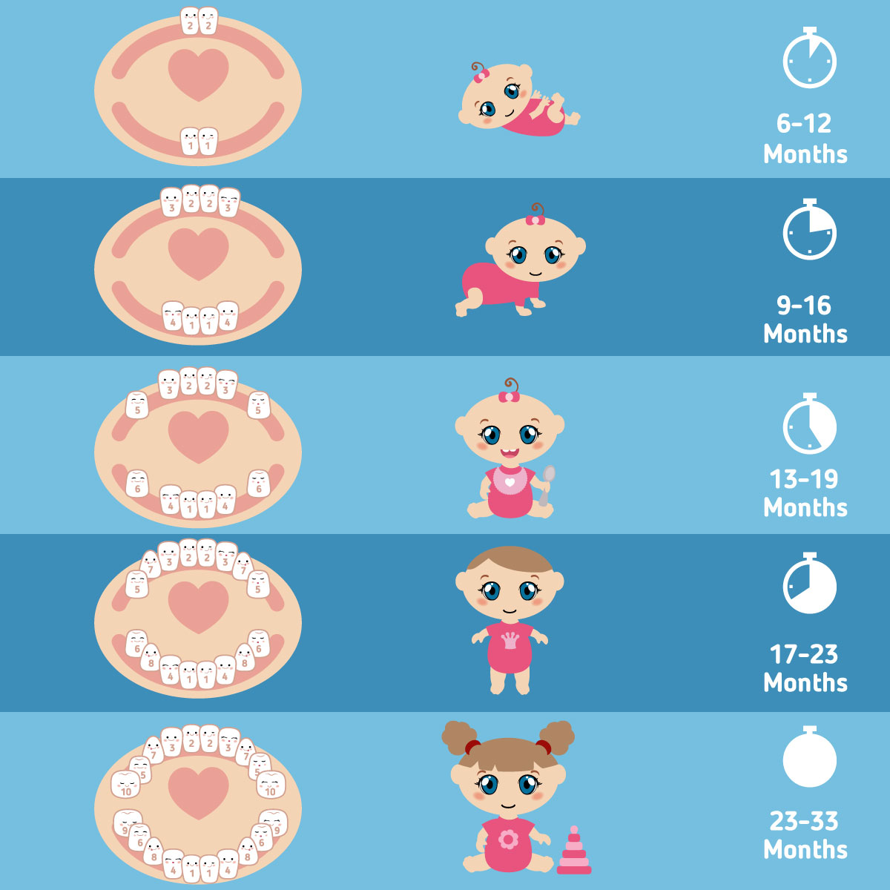
Why are Baby Teeth Important?
20 baby teeth
  Baby teeth hold space for permanent teeth
  Helps your little one smile, talk and chew
Baby teeth are important to take care
  Avoid baby bottle tooth decay
  Cavities can lead to infections and pain
  Brush, floss, eat well and get check ups!
Notes:
Why Are Baby Teeth Important?.
Starting around the 5th-6th months, baby teeth can start to appear. Over the years, children develop 20 baby teeth also known as primary or milk teeth.
Eventually these baby teeth “fall out” and get replaced with adult, permanent teeth.
Baby teeth still have a very important role.
They help your little one chew solid foods, smile, and talk.
Baby teeth are also space holders for the adult or permanent teeth which start coming out when kids are around 6 years old.
Milk is great as it provides nutrients for baby but if milk coats the baby’s teeth throughout the night, the sugars in the milk will cause repeated acid attacks that can weaken the enamel and lead to cavities. This effect is also known as Baby Bottle Decay or Early Childhood Caries.
You can avoid this severe decay pattern by not placing baby to bed with a bottle filled with milk, formula or liquids with sugar. It’s best to use water if they need a bottle in bed.
Also, remember to give a helping hand to your child while brushing until they are at least 7 years old. Even after that, it is good to check in frequently to see if they are removing plaque from hard to reach spots such as their back teeth.
Cavities and dental infections can also happen to kids. Since the enamel in primary teeth is extremely thin, kids can get cavities easily that reach to the deeper layers of the tooth faster. That’s why it’s important to get dental check ups every 6 months as soon as the first teeth appear.
Remember, the 1st dental check up should happen when the 1st tooth appears or close to your baby’s 1st birthday!
References
American Dental Association [ADA]. (n.d.). Mouth Healthy: 10 things to know about your tot’s teeth. Retrieved from https://www.mouthhealthy.org/en/babies-and-kids/kids-quick-tips?utm_source=mouthhealthyorg&utm_medium=mhkidsrotator&utm_content=toothcare

Slide 21
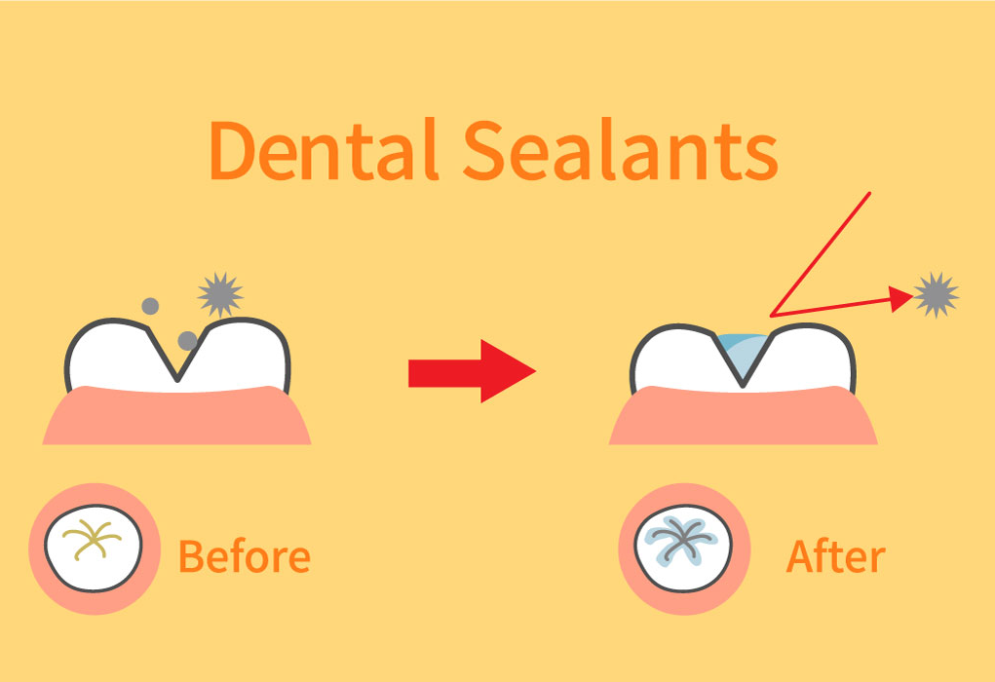
Caring for a Child’s Mouth
Dental Sealants for More Protection
By 6 years of age, kids develop their first adult molars
Dental sealants
Are placed on healthy teeth that do not have decay
Take a few minutes to place on a single molar
Help keep the tooth healthier longer
Notes:
Caring for Child’s Mouth
Another evidence-based practice that can reduce cavities are dental sealants, which provide more protection.
By age 6, kids develop their first adult molars. These teeth, located in the back, should stay in the mouth for life as they are very important to help chew foods.
To keep these teeth healthy, dental sealants may be recommended.
Dental sealants:
Are placed on healthy teeth that don’t have significant decay.
These molars have deep pits and grooves where sugary foods can get stuck and stay on there throughout the day.
Sealants coat the grooves of the teeth and can help to keep the chewing surfaces stay healthier, longer.
In fact, The American Dental Association states that “Sealants work: sealants on permanent molars reduce the risk of dental decay by 80%”.
That is why some schools have partnered with dental programs that come into classrooms to provide oral health education, screenings, fluoride varnish and sealants to consented children. A service such as this is convenient for parents/caregivers and allows many kids to have access to early, preventive care.
Remember the combination of fluoride, sealants and foods you choose can help keep dental cavities away!
Early habits started at a young age, allow your child to take on personal oral health habits during their later years to keep teeth healthy for life!
References:
American Dental Association [ADA]. (n.d.) Oral health topics: Dental sealants. Retrieved from https://www.ada.org/en/member-center/oral-health-topics/dental-sealants

Slide 22
Recap: 5 Steps of Prevention
Brush 2x a day: Morning and Night
Floss at least 1x a day: Before bed or after meals
Choose Fluoride: Toothpaste, mouthwash and fluoride in tap water strengthens teeth
Eat healthy meals: Limit sugary foods and choose water for drinking
Maintain regular check-ups: See a dentist 2x a year. Don’t delay necessary treatment
Schedule: A baby’s first dental visit when their first tooth appears or by their 1st birthday
Notes:
Recap: 5 Steps of Prevention
Brush 2x a day: Morning and Night.
Floss at least 1x a day: Before bed – important after meals.
Choose fluoride: toothpaste, mouthwash and systemic fluoride in tap water helps strengthen teeth and bones.
Eat healthy meals: limit sugary foods and choose water for drinking.
Maintain regular check-ups: See a dentist 2x a year. Don’t delay necessary treatment.
Schedule a baby’s first dental visit when their first tooth appears or by their first birthday, whichever comes first

Slide 23
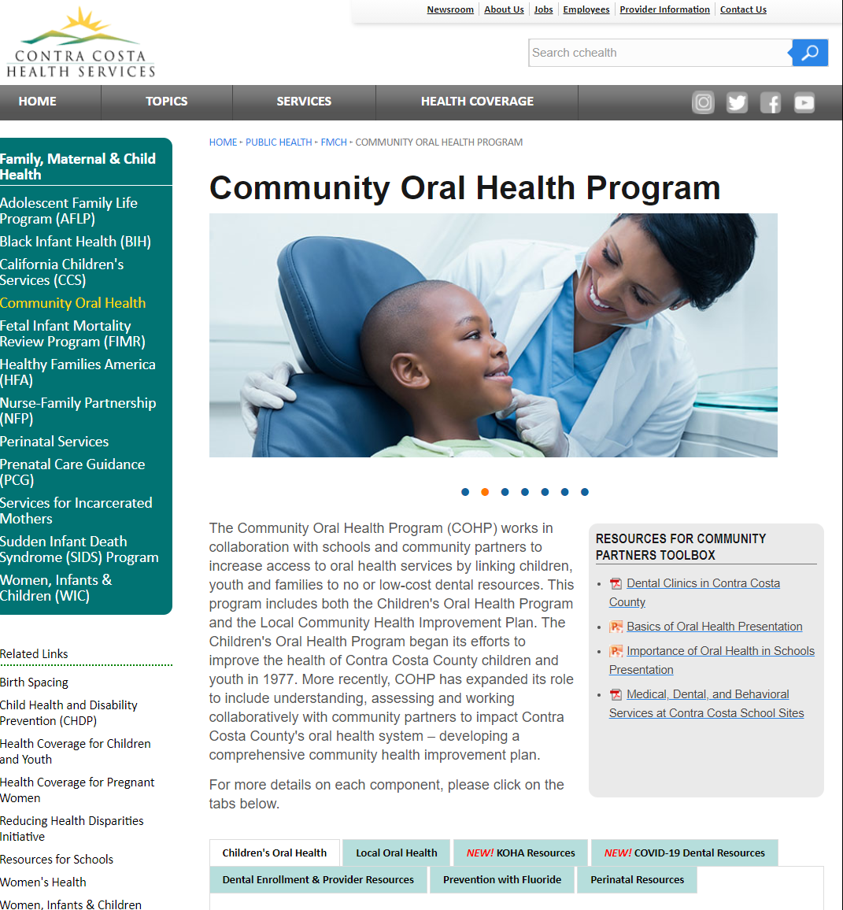
Community Oral Health Website
Community Oral Health Program
Activities for children and parents
Educational resources for community and partners
Enrollment for dental coverage information
Local efforts by community partners
Notes:
Community Oral Health Website:
To find local resources regarding oral health services and clinics within Contra Costa County. Please visit Contra Costa Health Services – Community Oral Health Website.

Slide 24

Community Oral Health Program Website
cchealth.org/dental
Notes:
Presentation Closing:
Provide presenting staff contact information– and Community Oral Health Program contact information.
Thank participants – remind audience, the Contra Costa Oral Health Program provides presentation resources online at cchealth.org/dental.

