Slide 1
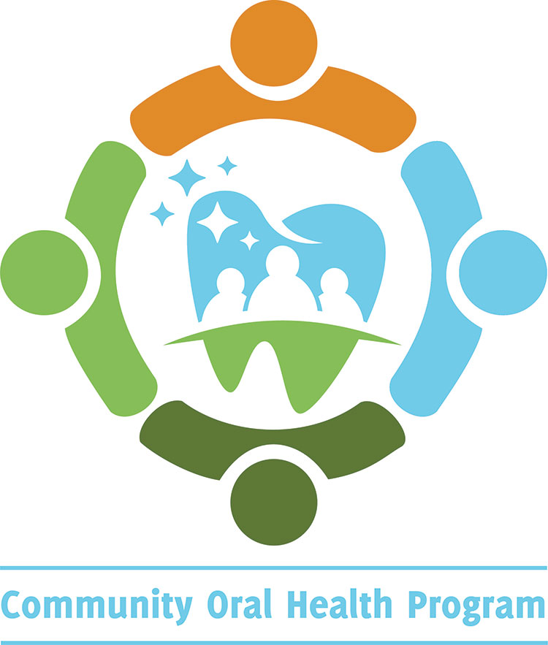

Importance of
Oral Health in Schools
Promoting the Kindergarten Oral Assessment (KOHA)
Contra Costa Health Services
Community Oral Health Program (COHP)
Staff Names:
Date:
11/20
Notes:
Introduction:
Introduce yourself and the program
Power Point is available online: (cchealth.org/dental)
Ask audience if there are any questions before beginning. Consider writing suggestions or questions on paper/board for follow up.
Encourage audience to ask questions.
Note from the Contra Costa Community Oral Health Program: Please customize slides to adapt to your program.

Slide 2
To Learn
& Review
Supporting Oral Health Efforts
Key Takeaways
The Importance of Oral health
The Impact of Oral Health on Schools
The Kindergarten Oral Health Assessment Form
Requirements of Schools
Notes:
To Learn and Review:
The Importance of Oral Health
The Impact of Oral Health on Schools
The Kindergarten Oral Health Assessment Form (KOHA)
Requirements of Schools
Supporting Oral Health Efforts
Key Takeaways

Slide 3
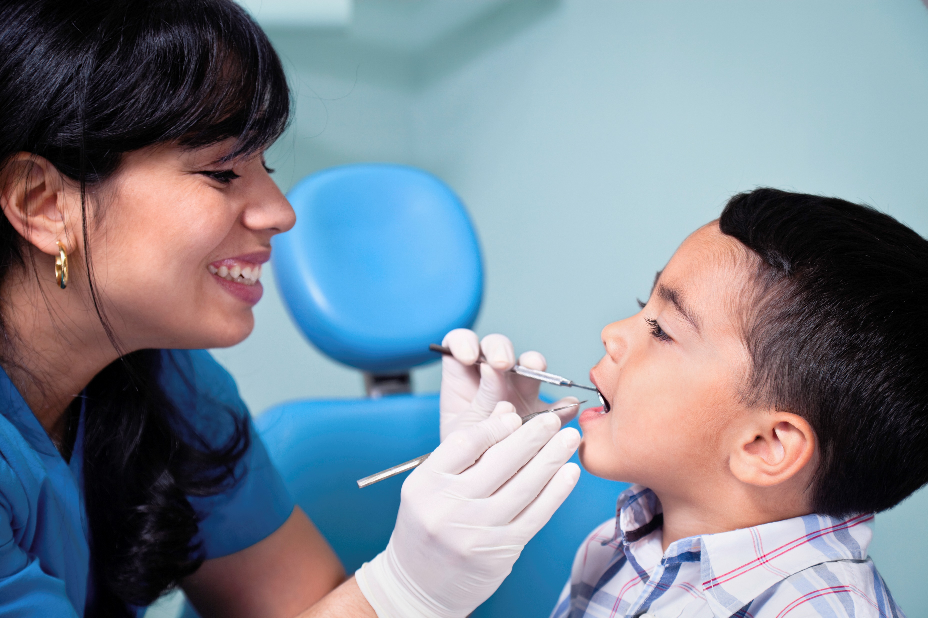
Why is Oral Health Important?
  Oral health is connected to overall health
  Impacts the ability to speak, smile, taste and digest food needed for proper nutrition
  Affects the daily quality of life
Notes:
Why is Oral Health Important:
It is all connected - the health of the mouth influences aspects of general health.
The mouth is the gateway to the body.
Teeth and salvia begin the first steps of digestion to get vital nutrients.
Teeth also help us to speak and smile which can directly impact our physical and mental well-being.
For children, oral health problems can make it difficult to eat food, sleep at night or socialize with other children. – (CDC)
For example, having a healthy, pain free mouth can make it easier to concentrate at school or work.
References:
Center for Disease Control and Prevention, CDC. (2019, July 29). Children’s Oral Health. Retrieved from https://www.cdc.gov/oralhealth/basics/childrens-oral-health/index.html

Slide 4
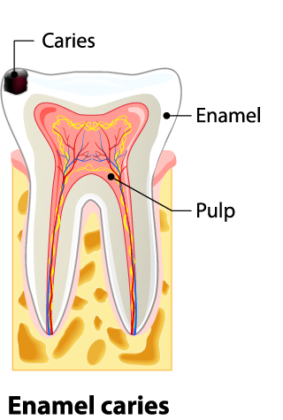
What Are Cavities?
A cavity develops when a tooth decays or breaks down, leaving a hole.
Our mouth has plaque which is a sticky film of bacteria that constantly forms on our teeth. When we eat or drink foods containing sugars, the bacteria in plaque produces acid that breakdown the outer layer of the tooth called enamel. Repeated acid attacks can lead to cavities.
An untreated cavity can cause pain and infection. At times, this can spread to other parts of the body, causing even more harm to our health.
Prevention
Brushing 2x a day
Flossing at least 1x day
Eating healthy snacks
Notes:
What Are Cavities:
Cavities, also referred to as dental caries or tooth decay, is a disease process that can leave a hole or a cavity in the tooth.
Our mouth has plaque which is a sticky film of bacteria that constantly forms on our teeth. When we eat or drink foods containing sugars, the bacteria in plaque produce acids that breakdown the outer layer of the tooth called enamel. Repeated acid attacks can lead to cavities.
An untreated cavity can get bigger and deeper into the tooth eventually leading to pain and/or infection. If the infection is not addressed, it can spread to other parts of the body causing serious harm to our health.
Fortunately, cavities are largely preventable through maintaining proper oral hygiene that includes a few, simple and consistent steps. Please follow these and encourage young children as well to brush at least 2x a day, floss at least 1x a day and select nutritious snacks.
References:
Center for Disease Control and Prevention, CDC. (2019, May 22). Oral Health Conditions. Retrieved from https://www.cdc.gov/oralhealth/conditions/index.html
ADA.org: American Dental Association

Slide 5
The Impact of Oral Health on Schools
Dental caries is the most common chronic childhood disease in the U.S. It is nearly 5x more common than childhood asthma.
In the U.S. 6.3 million children suffer from poor oral health by the time they reach 3rd grade.
Poor oral health impacts a child’s overall health through nutrition, speech, self-esteem and academic performance.
Notes:
The Impact of Oral Health on Schools:
Now that we see how tooth decay can be harmful to our body, let’s explore the consequences it can have on our students at school.
With A Show of Hands: Ask – How Many Know- that “Dental caries is the most common chronic childhood disease in the U.S? It is 5 times more common than childhood asthma”– (Benjamin R.M.)
In the U.S. 6.3 million or about 2/3^{rds} of all children suffer from poor oral health by the time they reach 3rd grade. (The California Smile Survey)
Poor oral health impact’s a child’s overall health including nutrition, speech, self esteem, and academic performance. (Children Now)
A child who has untreated cavities can sometimes have trouble chewing or dental pain, making it hard to focus in class. This can have negative impacts on their academic performance and school attendance. In fact, Head Start officials stress that physical health supported by maintaining good oral hygiene helps a child’s educational future. - KOHA Talking Points (U.S. Department of Health and Human Services)
References:
Script and talking points have been adapted from UCSF and California Oral Health Technical Assistance Center – KOHA Talking Points. To find out more information please visit their website at https://oralhealthsupport.ucsf.edu/koha-toolkit
Benjamin R. M. (2010). Oral health: the silent epidemic. Public health reports (Washington, D.C. : 1974), 125(2), 158–159. https://doi.org/10.1177/003335491012500202
Children Now. Sacramento County KOHA Workshop, Andrew, K. (2019, February 4). Kindergarten Oral Health Assessment (KOHA) County-Level Case Studies Project. [PowerPoint Slides].
The California Smile Survey. The California Smile Survey: An Oral Health Assessment of California’s Kindergarten and 3rd Grade Children. (2006, February). “Mommy, It Hurts to Chew.” Retrieved from Dentistry UCSF.
U.S. Department of Health and Human Services. (2013). Making the Link between Health and School Readiness.

Slide 6
The Impact of Oral Health on Schools
Children with poor dental health are 3x more likely to miss school than their healthy peers
Each year ½ million California children miss school due to dental problems
Averaging to 874,000 missed schools per year in California
Costing CA State Public Schools at least $29 Million in average daily attendance funding
Notes:
The Impact of Oral Health on Schools
Poor oral health also has both direct and indirect consequences on schools.
Absence rates may rise as children and parents often will take time from work and/or school to get dental issues resolved.
Studies show children with poor dental health are 3 times more likely to miss school than their healthier peers. – (Jackson, S.L., Vann, W.F., Jr,..)
In fact, Statewide 1/2 million children miss school annually due to dental problems.- (CDA) California Dental Association
This averages to about 874,000 missed school days per year, costing California schools an estimated $29 to $32 million annually in average daily attendance funding. – (Children Now)
References:
Script and talking points have been adapted from the UCSF Technical Center – KOHA Talking Points. To find out more information please visit their website at https://oralhealthsupport.ucsf.edu/koha-toolkit
California Dental Association. Sacramento County Workshop [PowerPoint Slides]
Children Now. Sacramento County KOHA Workshop, Andrew, K. (2019, February 4). Kindergarten Oral Health Assessment (KOHA) County-Level Case Studies Project. [PowerPoint Slides].
Jackson, S. L., Vann, W. F., Jr, Kotch, J. B., Pahel, B. T., & Lee, J. Y. (2011). Impact of poor oral health on children's school attendance and performance. American journal of public health, 101(10), 1900–1906. https://doi.org/10.2105/AJPH.2010.200915

Slide 7
The Impact of Oral Health on Schools
Children with tooth pain are 4x more likely to have below average GPA
Low-income children are disproportionately affected
To address these issues, California legislators established the Kindergarten Oral Health Assessment, AB1433 in 2005
Notes:
The Impact of Oral Health on Schools
Data indicates that children with tooth pain are 4 times more likely to have below average GPA. This could be as a result of missed school days or trouble focusing in class due to pain. – (Children Now)
Research shows that student achievement suffers from absenteeism, regardless of school setting- whether in an urban, rural, or suburban community.
Unfortunately though, harm to learning from absences is greatest among our most vulnerable students – low-income children and English language learners –(Gershenson S, Jacknowitz A, Brannegan A) –Adapted from UCSF Technical Center (KOHA Talking Points)
Lowering student absenteeism rates is a major reason why in 2005 California legislators passed the bill on the Kindergarten Oral Health Assessment (KOHA) form. -Adapted from UCSF Technical Center (KOHA Talking Points)
References:
Script and talking points have been adapted from the UCSF Technical Center – KOHA Talking Points. To find out more information please visit their website at https://oralhealthsupport.ucsf.edu/koha-toolkit
Children Now. Sacramento County KOHA Workshop, Andrew, K. (2019, February 4). Kindergarten Oral Health Assessment (KOHA) County-Level Case Studies Project. [PowerPoint Slides].
Gershenson S, Jacknowitz A, Brannegan A. Institute for the Study of Labor, Discussion Paper No. 9448. (2015, December). Are Students Absences Worth the Worry in U.S. Primary Schools? Retrieved from http://ftp.iza.org/dp9558.pdf . Accessed from KOHA Talking Points. (2020) https://oralhealthsupport.ucsf.edu/koha-toolkit
U.S. Department of Health and Human Services. (2013). Making the Link between Health and School Readiness.

Slide 8
Kindergarten Oral Health Assessment (KOHA)
Raises oral health awareness and school readiness
Requires all children must have a dental screening by May 31 of the same year they enter public schools
Assessments must be completed by a licensed dental professionals
Dental evaluations that occurred within the 12 months before a child enters school also meets this requirement
KOHA helps school identify community needs and connects students to dental care
To find out if your school collaborates with partnering screening programs such as the Children’s Oral Health Program, please contact your local school setting
Notes:
Kindergarten Oral Health Assessment – KOHA
The Kindergarten Oral Health Assessment (KOHA) ensures all children are healthy and ready for school. Like the vision and hearing school screenings, California has a law that strongly encourages children receive an oral health screening as part of school entry by their first year of school in either kindergarten or first grade.
Data from these assessments so far have revealed that about 54% of entering kindergarteners have already experienced tooth decay. For perspective – if your local school has a kindergarten class of 20, over 10 of those kids will already have fillings in their teeth or active cavities. (California Department of Public Health).
Having KOHA in place not only helps raise a family's awareness to the importance of oral health but also helps schools identify and connect those students with untreated decay to preventive dental care. (California Dental Association)
Data collected from KOHA assists the State and local counties to get a more accurate picture of community needs and therefore, help to leverage dental resources where it is needed most .
To ensure that KOHA forms are successfully being completed, recorded and reported requires strong partnerships between parents, schools, and healthcare providers.
Within Contra Costa County, the Children’s Oral Health Program provides preventative dental screenings for children by partnering with school sites. Since 1977, this program which includes a licensed dental team, has continued to increase access to oral health services for children. More recently the Children’s Oral Health Program has expanded its efforts under the Community Oral Health Program to continue promoting county wide oral health efforts.
Some additional services also include oral health education, fluoride varnish, dental sealants and referrals to participating community dental clinics.
The Children’s Oral Health Program also partners with principals and teachers on strategies to increase both student and parental awareness around the benefits of these no cost preventive dental services.
To find more information regarding the Children’s Oral Health Program screenings, please check with your current local school district.
References:
Script and talking points have been adapted from the UCSF Technical Center – KOHA Talking Points, and UCSF Planting the Seeds for Educational Success PowerPoint. To find out more information please visit their website at https://oralhealthsupport.ucsf.edu/koha-toolkit
California Dental Association. Kindergarten Oral Health Requirement. Retrieved from: https://www.cda.org/Home/Public/Kindergarten-Oral-Health-Requirement
California Department of Public Health. (2017). Status of Oral Health in California: Oral Disease Burden and Prevention in 2017. Retrieved from https://www.cdph.ca.gov/Programs/CCDPHP/DCDIC/CDCB/CDPH%20Document%20Library/Oral%20Health%20Program/Status%20of%20Oral%20Health%20in%20California_FINAL_04.20.2017_ADA.pdf

Slide 9
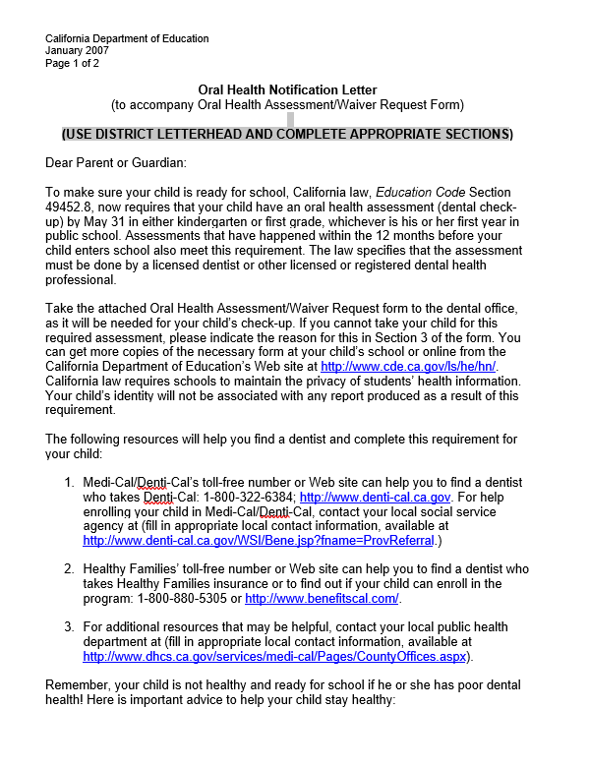
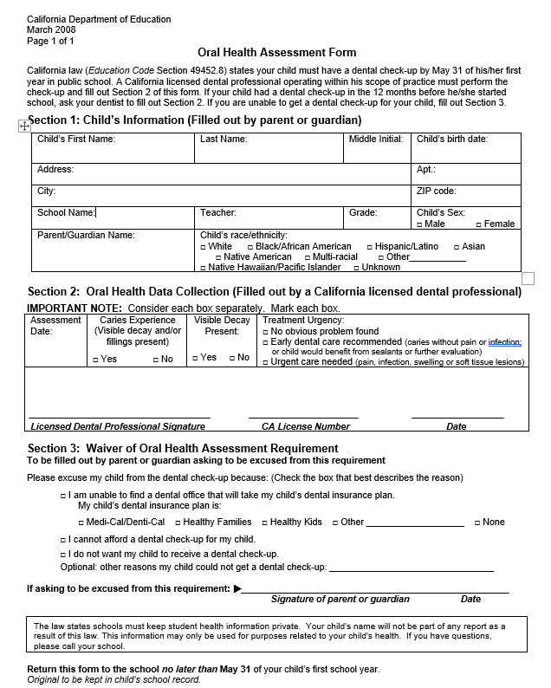
Oral Health Notification Letter
Oral Health Assessment Form
Notes:
Kindergarten Oral Health Assessment – KOHA
Samples of the Oral Health Notification Letter and Oral Health Assessment form distributed to parents from their local schools.
Note that the assessment form is just one page and requires an oral health professional to do a basic dental screening.
References:
California Dental Association. Kindergarten Oral Health Requirement. Retrieved from: https://www.cda.org/Home/Public/Kindergarten-Oral-Health-Requirement

Slide 10
Requirements of Schools
KOHA Important Dates:
July
Distribute KOHA Forms and Parent Notification Letters
May 31
Last day to collect KOHA forms
June/Last Day of School
Enter data into SCHOR database
September – May
Conduct & Collect KOHA forms
July 1st
Deadline for submissions
Expectations
  Communicate the importance of oral health and encourage parent/caregiver to seek dental check up for their child.
  Distribute the oral health assessment form and the parent notification letter to families.
  This includes oral health education material on school readiness and insurance enrollment information for Medi-Cal.
  Submit data retrieved from assessment forms into SCHOR Database or to the local school district office.
Notes:
KOHA - The Role of Schools:
Schools play a vital part in educating and supporting parents around the importance of oral health. By law, schools are required to give parents the KOHA form along with a parent notification letter. Oral Health Education and Medi-Cal Enrollment information are often given to families within this packet.– (California Dental Association)
In July, schools start to distribute forms and notification letters before the school year begins. This allows for the time beginning in September-May to conduct oral health assessments.
May 31st serves as the last day for forms to be collected from parents/caregivers.
Schools have the option to either enter individual school data into a national database titled “SCHOR” or submit data directly to their local district office by the end of school year. (California Oral Health Technical Assistance Center)
SCHOR, also known as the System for Oral Health Reporting is used by the Office of Education to analyze data entered in by schools.
The final deadline to submit all data on behalf of schools is July 1st.
Reported data may include but is not limited to the number of children who are subject to the requirement, the number of returned and not returned assessment forms, dental caries/untreated decay experienced and the number of requested waiver count. – (California Dental Association)
References:
California Dental Association. Kindergarten Oral Health Requirement. Retrieved from: https://www.cda.org/Home/Public/Kindergarten-Oral-Health-Requirement
California Oral Health Technical Assistance Center. Kindergarten Oral Health Assessment. Retrieved from: https://oralhealthsupport.ucsf.edu/our-programs/school-programs/kindergarten-oral-health-assessment#How-can-local-health-jurisdictions-schools-and-providers-help-promote-the-Kindergarten-Oral-Health-Assessment

Slide 11
Requirements of Schools
Data collected from KOHA will identify:
Children entering kindergarten who have untreated tooth decay
Children entering kindergarten who have an urgent need for care
Children who do not dental insurance. Offer families support with dental resources such as Medi-Cal enrollment
Highlight dental needs and expand outreach within our local community
Notes:
Requirements of Schools
Data from the KOHA forms can help highlight dental resources and target outreach efforts to improve oral health in our local community. This seamless collaboration between schools, parents and community partners can have an exponential impact for our children.
Examples may include bringing mobile dental services to schools and community sites.

Slide 12
KOHA & The Role of Parents
Parents will receive notification of KOHA requirement and KOHA reporting assessment form
Parents have the option:
Assessments waiver may be completed if:
Hand in the assessment form once completed by a licensed dental
Forms must be completed and returned to school by May 31 of the school
Parents are unable to find a dental professional to do the evaluation
The assessment form proposes as an undue economic burden
The parent chooses not to have their child’s oral health evaluated
year
provider or fill out the assessment-waiver portion of the form
Notes:
KOHA and The Role of Parents/Option slide for SCHOR:
Many schools distribute the KOHA form and parent notification letter prior to beginning of the school year to prepare new parents and caregivers for registration as their child enters public school for the first time. Parents are encouraged to review the simple three question form to determine if their child is due to see their dental care professional.
If so, they should schedule, follow up and bring along the KOHA form to be filled out at their child’s next dental check up. If their child has already received an oral screening within the last 12 months before the start of school, they should coordinate with the dental care provider’s office to have the KOHA form filled out.
Parents of children who have never seen a dentist or are want to connect to care can review the attached parent notification letter for details on resources such as Medi-Cal, which includes dental coverage for kids.
Schools can inform families if they partner with oral health programs that come into classrooms to provide dental screenings.
Parents have the option to complete the assessment form or complete an assessment-waiver form.
Waiver forms should only be used if parents can not find a dental professional to do the evaluation or if the assessment form poses and economic burden or if they choose not to have their child’s oral health evaluated. (California Dental Association)
References:
California Dental Association. Kindergarten Oral Health Requirement. Retrieved from: https://www.cda.org/Home/Public/Kindergarten-Oral-Health-Requirement

Slide 13

How can I help?
Connect
Connect with your school administrators to identify a Champion!
Having one person appointed to oral health messaging
can help families understand the assessment form process
Highlight
Highlight oral hygiene and care in the classroom and with parents
Encourage parents to take children and families for a dental check-up
Use Smile California coloring and educational materials to enhance classroom curriculum
Encourage
Encourage healthy snacking and alternative prizes
Ask parents to bring or share party prizes such as pencils, erasers and notepads
instead of sugary snacks during classroom parties and celebrations
Notes:
Supporting Oral Health Efforts in Schools – How can I help?
Schools play such an important role in communicating to both children and families on the importance of oral care.
A great way to support oral health at your school is to encourage school administrators to identify a champion.
This designated person can help organize existing resources and emphasize the importance of screenings and reporting to both administrators and families.
Champions can also inspire their colleagues to explore the Smile California website and integrate oral health care in fun ways within the classroom. This website offers a variety of appropriate grade level activities with topics like going to the dentist and the science behind dental decay.
Often teachers and front office staff are the first point of contact for many families. Please consider encouraging parents to complete the KOHA, utilize dental prevention services and take their families for regular dental check-ups in order from them be ready for school!
Healthier nutrition options such as offering less sugary, sticky snacks as rewards or prizes during classroom celebrations is a great tip for achieving a healthier mouth.

Slide 14
5 Steps of Prevention
Brush 2x a day: Morning and Night
Floss at least 1x a day: Before bed or after meals
Choose Fluoride: Toothpaste, mouthwash, and fluoride in tap water strengthens teeth
Eat healthy meals: Limit sugary foods and choose water for drinking
Maintain regular check-ups: See a dentist 2x a year. Don’t delay necessary treatment
Notes:
5 Steps of Prevention:
To help schools get started on introducing oral curriculum for children, the following five prevention steps are recommended when discussing oral health topics:
Maintaining general health and oral health including healthy lifestyle habits.
Brushing 2x a day: Morning and Night.
Flossing at least 1x a day: Before bed – important after meals.
Choose fluoride: toothpaste, mouthwash and systemic fluoride in tap water helps strengthen teeth and bones.
Eating healthy meals: limit sugary foods and choose water for drinking.
Maintaining regular check-ups: See a dentist 2x a year. Don’t delay necessary treatment.

Slide 15
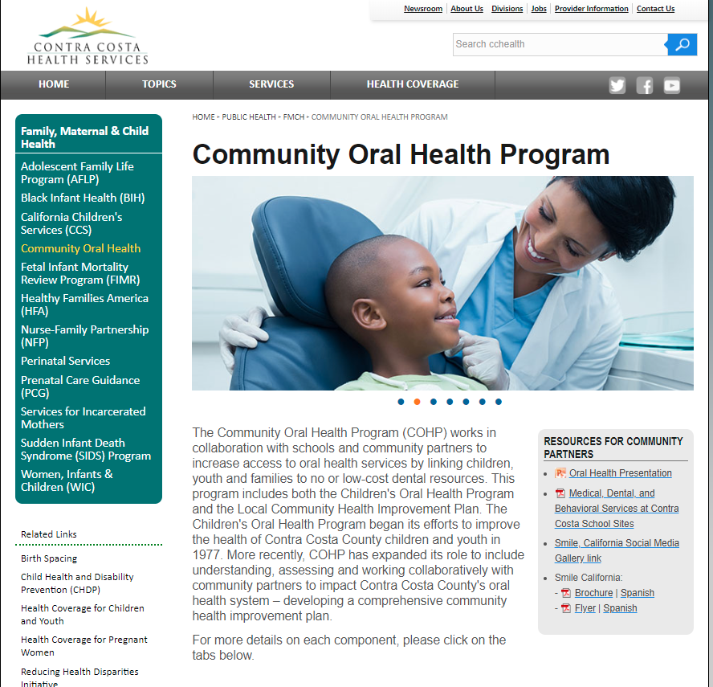
Community Oral Health Website
Community Oral Health Program
Check out more info on:
Local efforts by community partners
Educational Resources
Enrollment for dental coverage information
Links to professional organizations
Much More!
Notes:
Community Oral Health Website:
To find local resources regarding oral health services and clinics within Contra Costa County. Please visit Contra Costa Health Services – Community Oral Health Website.

Slide 16
5 Takeaways
Oral health is connected to overall general health
Poor oral health can impact a child’s school readiness and academic performance
The Kindergarten Oral Health Assessment (KOHA) form is required for children entering public school for the first time – Kindergarten or First grade
Schools can support KOHA and oral health efforts by educating families on the importance of a child receiving a dental check-up
For KOHA support, schools can utilize their local Office of Education for KOHA next steps, resources and information
Notes:
Key Takeaways:
Five key takeaways to highlight from this lesson include the following:
Oral Health is connected to overall general health.
Poor oral health can impact a child’s school readiness and academic performance.
The Kindergarten Oral Health Assessment (KOHA) form is required for children entering public school for the first time – Kindergarten or First Grade.
Schools can support KOHA and oral health efforts by educating families on the importance of a child receiving a dental check-up.
For Contra Costa County schools, please visit our local office of Education in Pleasant Hill, California or visit their website at www.cocoschools.org

Slide 17

Community Oral Health Program Website
Notes:
Presentation Closing:
Provide presenting staff contact information– and Community Oral Health Program contact information.
Thank participants – remind audience, the Contra Costa Oral Health Program provides presentation resources online at cchealth.org/dental.

