Slide 1

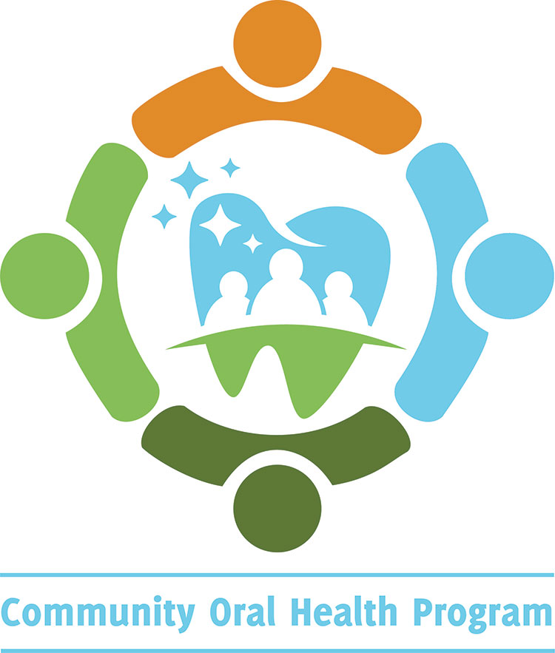
Basics of Oral Health Presentation
Contra Costa Health Services
Community Oral Health Program (COHP)
Staff Names:
Date:
Revised 12/26/19
Notes:
Introduction:
Introduce yourself and the program
PowerPoint is available online: (cchealth.org/dental)
Ask audience if there are any topics that they would like to discuss. Consider writing suggestions or questions on paper/board for follow up.
Encourage audience to ask questions.
Note from the Contra Costa Community Oral Health Program: Please customize slides to adapt to your program.

Slide 2
To Learn and Review:
The importance of oral health
Prevalence of disease
Dental terminology
Prevention
Community Oral Health Resources
Key Takeaways
Notes:
To Learn and Review:
The importance of oral health
Prevalence of disease
Dental terminology
Prevention
Community oral health resources
Key takeaways

Slide 3

Why Is Oral Health Important?
  Oral health is connected to your general health
  Impacts the ability to speak, smile, taste and digest proper nutrition
  Affects one’s everyday quality of life
Notes:
Why is Oral Health Important:
Key: Oral Health is connected to one’s general health.
It is all connected - the health of the mouth influences other aspects of overall health.
Studies show that oral health is linked to systemic diseases like cardiovascular and diabetes.
The mouth is the gateway to the body. Teeth and salvia begin the first step to digestion and getting vital nutrients.
Teeth also help us to speak and smile and can directly impact one’s physical and mental well-being.
For example, having a healthy, pain free mouth can help one concentrate at school or obtain a job.

Slide 4
Prevalence of Oral Disease
Dental caries is the most common chronic disease of childhood
Periodontitis Disease (Deep Gum Disease) affects almost 50% of U.S. Adults
50,000 cases of oral cancers are diagnosed annually in the U.S.
Tooth decay can be prevented!
Notes:
Prevalence of Oral Disease:
Key: Tooth decay is chronic but can be prevented with proper oral hygiene and action for one’s own health.
Dental caries is the most common chronic disease of childhood – 5x more common than asthma.
50,000 cases of oral cancer in the United States.
Periodontitis Disease (Deep Gum Disease) affects almost 50% of U.S. adults.
Tooth decay can be prevented:
Practice good oral hygiene including flossing, brushing, and nutrition.
References:
Dye BA, Xianfen L, Beltrán-Aguilar ED. Selected Oral Health Indicators in the United States 2005–2008. NCHS Data Brief, no. 96. Hyattsville, MD: National Center for Health Statistics, Centers for Disease Control and Prevention; 2012.
Eke PI et al. Prevalence of periodontitis in adults in the United States: 2009 and 2010. Journal of Dental Research. 2012 Oct;91(10):914-20.
National Cancer Institute Surveillance, Epidemiology, and End Results Program https://seer.cancer.gov/statfacts/html/oralcav.html

Slide 5
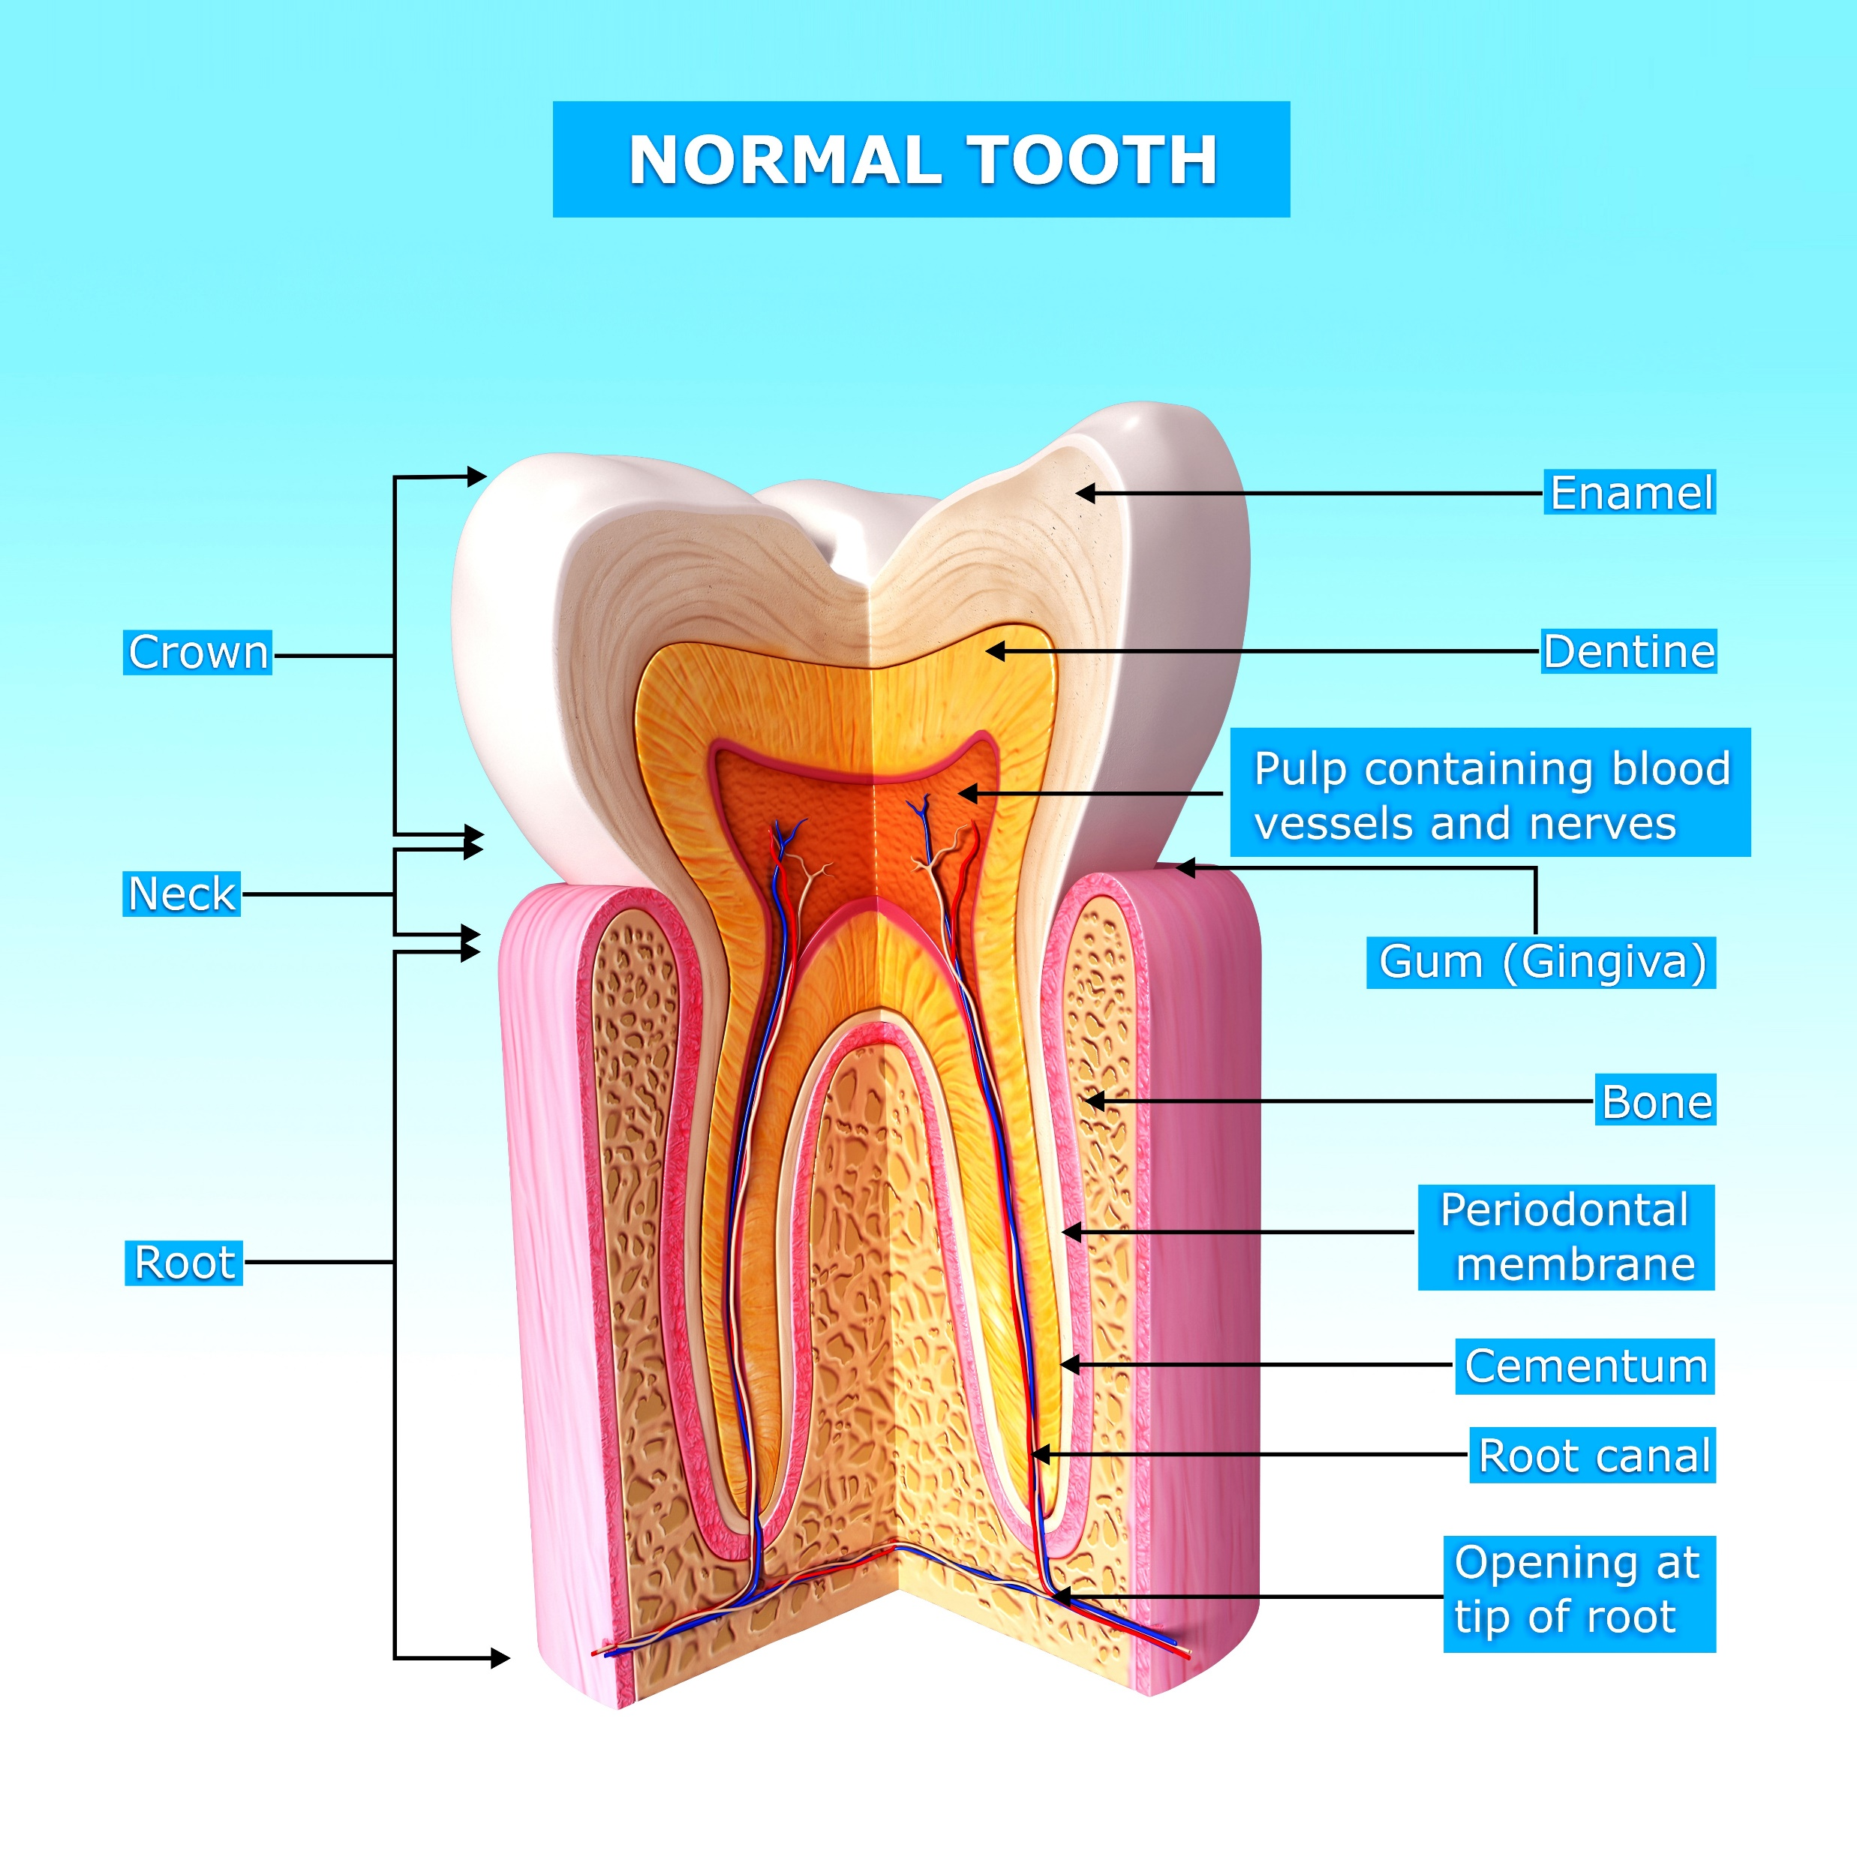
Tooth Anatomy
Notes:
Tooth Anatomy:
On average people have 20 primary/baby teeth and 32 permanent teeth.
Teeth are composed of layers including– the enamel, dentin, and the pulp.
The enamel is the protective outer layer of our teeth covering the dentin.
The enamel is the hardest substance found in the body.
Dentin is the second layer of our teeth that contains microscopic tubules or small canals to the root of the tooth. When dentin loses its protective covering (enamel), the tubules allow heat and cold or acidic/stick foods to stimulate the nerve and cells inside the tooth, causing pain and sensitivity.
Below the dentin is the pulp where nerves and blood supply for the tooth live.
References:
California Department of Public Health, Office of Oral Health. Oral Health 101: Preventing Dental Decay in Children. PowerPoint Presentation.
“Cavities: What Are They and How Do We Prevent Them?” Mouth Healthy TM, www.mouthhealthy.org/en/dental-care-concerns/how-do-we-prevent-cavities.
“Tooth.” Mouth Healthy TM, www.mouthhealthy.org/en/az-topics/t/tooth.

Slide 6
What Are Cavities?
Also known as Tooth Decay
Cavities occur when bacteria in plaque metabolize dietary sugar to make acid. The acid demineralizes the tooth and creates a “cavity”
Continuous acid attacks can cause the enamel (first layer) of the tooth to break down
Refined sugars found in candy, crackers and soda make it easier for bacteria to breakdown into acid
Cavities can happen on any surface of the tooth
Saliva acts as a natural defense to help repair enamel
Notes:
What Are Cavities:
Tooth decay, also referred to as cavities/dental caries is a result of a process that can leave a hole or a cavity in the mouth.
Our mouth is full of bacteria. Tooth decay begins when a type of bacteria called streptococcus mutans feeds on sugar or carbohydrates and produces acid. Repeated cycles of these acid attacks can cause enamel, the first layer of the tooth to break down.
These acid attacks can last for 20 minutes after eating.
Refined sugars found in foods such as candy, crackers and soda make it easier and faster for bacteria to metabolize or breakdown into acid. Choosing more complex carbohydrates found in vegetables and fruits are a better choice as the texture and crunch stimulates saliva.
Cavities can help on any surface of the tooth (top, and in between the teeth). Cavities can impact both baby and adult teeth.
Luckily, we can slow these process by natural defenses like salvia or spit. In early stages, enamel can repair itself by using minerals from salvia. We can also try to consume or rinse with water after eating.

Slide 7
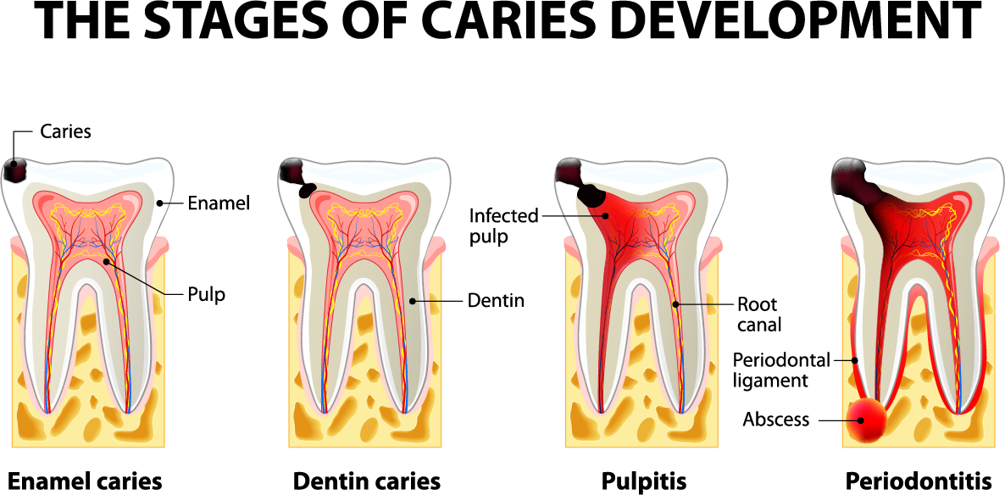
Stages of Tooth Decay
Notes:
Stages of Tooth Decay:
The first stages of decay start with the enamel or top layer of the tooth.
Overtime, exposure to acid attacks may cause dental decay. If bacteria from dental decay travels from the dentin into the pulp, it may infect the dental pulp and drain out of the root of the tooth creating an abscess –infection.
Untreated dental decay can cause pain and/or swelling that may require medical attention if not treated.
References:
California Department of Public Health, Office of Oral Health. Oral Health 101: Preventing Dental Decay in Children. PowerPoint Presentation.
“Cavities: What Are They and How Do We Prevent Them?” Mouth Healthy TM, www.mouthhealthy.org/en/dental-care-concerns/how-do-we-prevent-cavities.

Slide 8
Dental Decay
Dental Infection
Risk Factors
Symptoms
Serious and life-threatening if not treated
When the problem is small seek treatment to prevent infection
Frequent snacking between meals
Consuming high amounts of sugary foods and drinks
Medications that may cause dry mouth
Swelling of the face or in the mouth
Redness in or around the mouth
Pain in the mouth
Bad taste or change in the mouth
Notes:
Dental Decay:
Key: Dental infections can be serious and life threatening if not treated.
If a cavity is left untreated it can get larger and eventually cause an infection that affects the body.
The infection can produce symptoms such as facial swelling which can be life threating if it blocks the airway.
Therefore, having regular dental check ups and treatment if necessary, can help from potential problems in the mouth from getting worse.
Risk factors include frequent snacking between meals, consumption of sugary drinks and foods, and taking medications that may cause dry mouth. Dry mouth may increase the chances of cavities.
Look for signs of changes within and around the mouth – swelling, redness, pain, or bad taste in the mouth.
References:
“Cavities: What Are They and How Do We Prevent Them?” Mouth Healthy TM, www.mouthhealthy.org/en/dental-care-concerns/how-do-we-prevent-cavities.

Slide 9
Preventing Tooth Decay
Ask your Provider about:
Fluoride
  Fluoride: Naturally-occurring mineral that helps protect against cavities by making the outer surface of the teeth more resistant to acid attacks
  Fluoride Varnish: Protective coating that is painted on the teeth to help prevent new cavities and stop cavities that have already started
  Topical fluoride: Found in toothpaste and mouthwash helps to protect the teeth
  Systemic fluoride: Found in tap water helps strengthen bones and teeth
Dental Sealants
  Sealants are protective plastic coating that can be applied to the chewing surfaces of the back teeth where decay often starts
  Sealants protects the grooves within the teeth from bacteria that may cause cavities
Notes:
Preventing Tooth Decay:
Key: Prevention includes maintenance of regular dental check-ups.
Fluoride:
Fluoride: A naturally-occurring mineral, helps prevent cavities in children and adults by making the outer surface of your teeth (enamel) more resistant to the acid attacks that cause tooth decay.
Fluoride Varnish: Protective coating that is painting on the teeth that prevents new cavities.
Topical fluoride and systemic fluoride helps strengthen bones and teeth.
Dental Sealants
Protective plastic coating applied to the chewing surfaces of the back teeth to prevent against cavities.
References:
“Fluoride.” Mouth Healthy TM, www.mouthhealthy.org/en/az-topics/f/fluoride.
“Sealants.” Mouth Healthy TM, www.mouthhealthy.org/en/az-topics/s/sealants.

Slide 10
What is Plaque?
A sticky, colorless to tooth-colored film containing bacteria that forms daily around the teeth
Plaque that is not removed with daily brushing and cleaning between teeth can eventually harden into calculus or tartar
Can result in cavities or irritation of the gums
Notes:
What is Plaque:
Sticky, colorless to tooth colored film containing bacteria that forms daily around the teeth.
Plaque overtime, includes build of bacteria including saliva and food particles.
If plaque is not removed can eventually harden into calculus or tartar.
May result in cavities or irritation of the gums when tartar collects above the gum line (gingivitis).
References:
California Department of Public Health, Office of Oral Health. Oral Health 101: Preventing Dental Decay in Children. PowerPoint Presentation.
“Plaque.” Mouth Healthy TM, www.mouthhealthy.org/en/az-topics/p/plaque.

Slide 11
Types of Oral Disease
Gingivitis – Inflamed gums: red, swollen and bleeding caused by plaque or hormonal changes.
Periodontitis – Chronic gum disease that may lead to permanent bone loss and tooth mobility.
Substance use and abuse – Severe alcohol and drug usage can increase tooth decay, risk of certain oral cancers and permanent tooth loss.
Oral cancer - Early signs may include a sore, color change of oral tissue, pain or lump. Can occur with no risk factors, however often associated with tobacco use.
Notes:
Types of Oral Disease:
Gingivitis – inflamed gums, red, swollen and bleeding cause by plaque or hormonal changes.
Periodontitis – chronic gum disease that may lead to permanent bone loss and tooth mobility.
Substance use and abuse – severe alcohol and drug usage can damage the mouth and may increase risk of certain oral cancers and permanent tooth loss.
Oral cancer – early signs may include sores in the mouth including color change of the oral tissue, pain or lump within the mouth. Oral cancer occur with no risk factors, however often associated with tobacco use.

Slide 12
5 Steps of Prevention
Brush 2x a day: Morning and Night
Floss at least 1x a day: Before bed or after meals
Choose Fluoride: Toothpaste, mouthwash, and systemic fluoride in tap water strengthens teeth
Eat healthy meals: Limit sugary foods and choose water for drinking
Maintain regular check-ups: See a dentist 2x a year. Don’t delay necessary treatment
Notes:
5 Steps of Prevention:
Key: Prevention includes maintaining general health and oral health including healthy lifestyle habits.
Brush 2x a day: Morning and Night.
Floss at least 1x a day: Before bed – important after meals.
Choose fluoride: toothpaste, mouthwash and systemic fluoride in tap water helps strengthen teeth and bones.
Eat healthy meals: limit sugary foods and choose water for drinking.
Maintain regular check-ups: See a dentist 2x a year. Don’t delay necessary treatment.

Slide 13
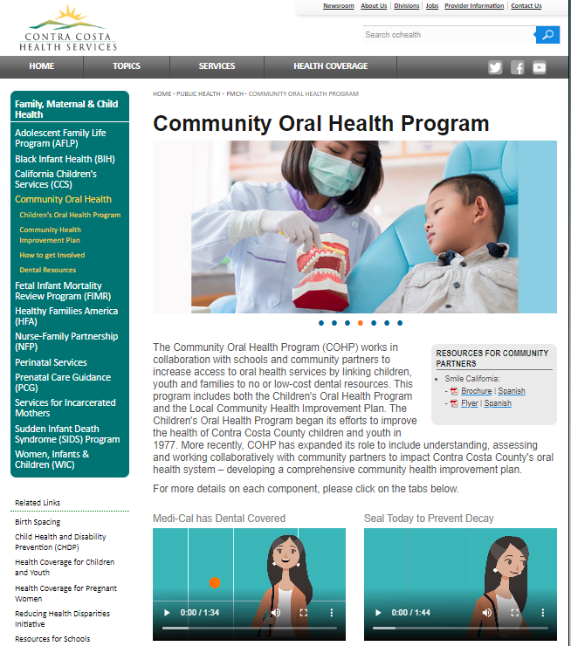
Community Oral Health Website
Community Oral Health Program
Community Dental Resources
  Dental Clinics in Contra Costa
Community Resources for Partners
  General Oral Health Presentation and Oral Health Topics
  Smile California (Medi-Cal Dental)
  Medical, Dental, and Behavioral Services at Contra Costa school sites
Notes:
Community Oral Health Website:
Key: Oral Health Resource: Link to Local Dental resources within Contra Costa County
Dental clinics and contact information to partnering dental clinics.
Resources for community partners to educate staff including educational materials – Medi-Cal videos and PowerPoints from COHP on various topics of Oral Health: Perinatal, CYWSCHN, School staff, PCLG and overview of Oral Health coming soon.
Highlights of Local Oral Health Efforts – learn about our process – systems map, read needs assessment and timeline.

Slide 14
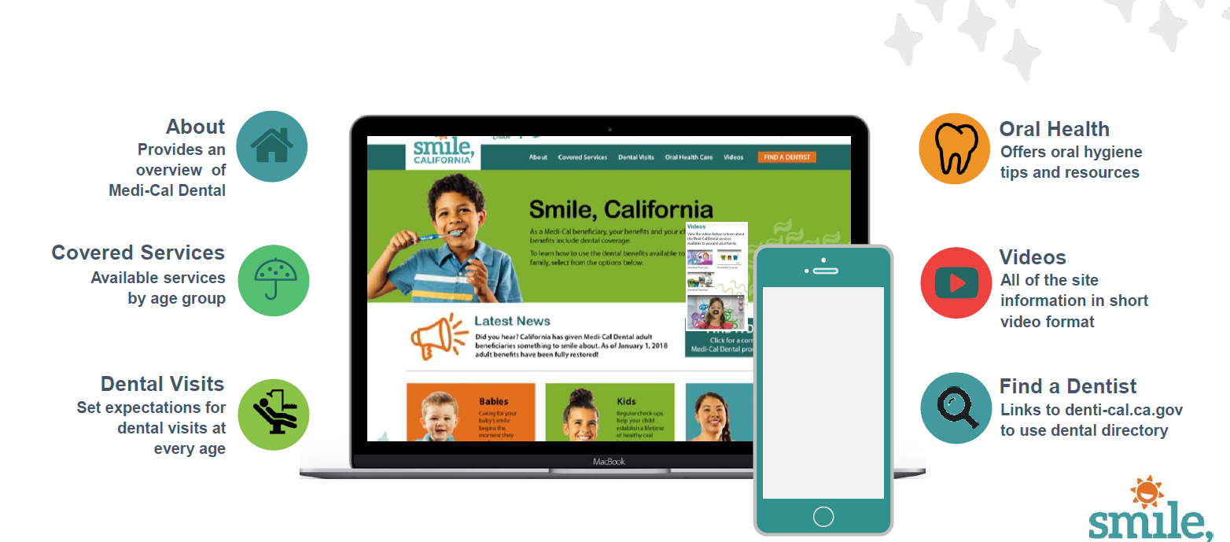
Smilecalifornia.org
Notes:
Smile California:
Key: Message Medi-Cal patients have dental coverage
Smile California is a campaign to help Medi-Cal members to learn about covered dental services and find a qualified provider.
Medi-Cal members can find dental providers at SmileCalifornia.org
Baby’s should visit the dentist with the first tooth or first birthday.
Children with Medi-Cal can visit the dentist every 6 months for free.
Sealants can help protect children’s molars from cavities .
Also to encourage dentist to become Medi-Cal Providers.

Slide 15
5 Takeaways of Oral Health
Oral health is connected to your general health
Oral health can affect one’s quality of life – physical, social and mental well-being
Tooth decay is a chronic issue that can be prevented
Prevention includes maintaining good oral hygiene and healthy lifestyle habits
We can support our community by providing oral health resources
Notes:
5 Takeaways of Oral Health:
Oral health is connected to your general health
Oral health can affect one’s quality of life – physical, social and mental well-being. The health of the mouth influences other aspects of health.
Tooth decay is chronic but can be prevented with proper oral hygiene.
Prevention includes maintain good oral hygiene but also lifestyle habits – nutrition, check-ups, etc.
Providing oral health resources can help support our community members and encourage access to oral care.

Slide 16


Community Oral Health Program
By Phone: (925)313-6280
Online: Community Oral Health Program
Notes:
Presentation Closing
Provide presenting staff contact information– and Community Oral Health Program contact information.
Thank participants – remind audience, the Contra Costa Oral Health Program provides presentation resources online at cchealth.org/dental.
Suggested: Pass out evaluation forms, remind participants that they can omit their name.

